Slide 1
Development of a Multifactor Forecasting Method for Dependability Measures of IIoT‐Systems
27th International Conference on Distributed Computer and Communication Networks: Control, Computation, Communications
Computer and Communication Networks: Architecture, Protocols and Technologies
RUDN University, Moscow, Russia
Authors: Viacheslav Tsvetkov, student, HSE University
Sergey Polesskiy, Candidate of Technical Sciences, HSE University
Pavel Korolev, Candidate of Technical Sciences, HSE University
Leonid Lander, student, HSE University

Slide 2
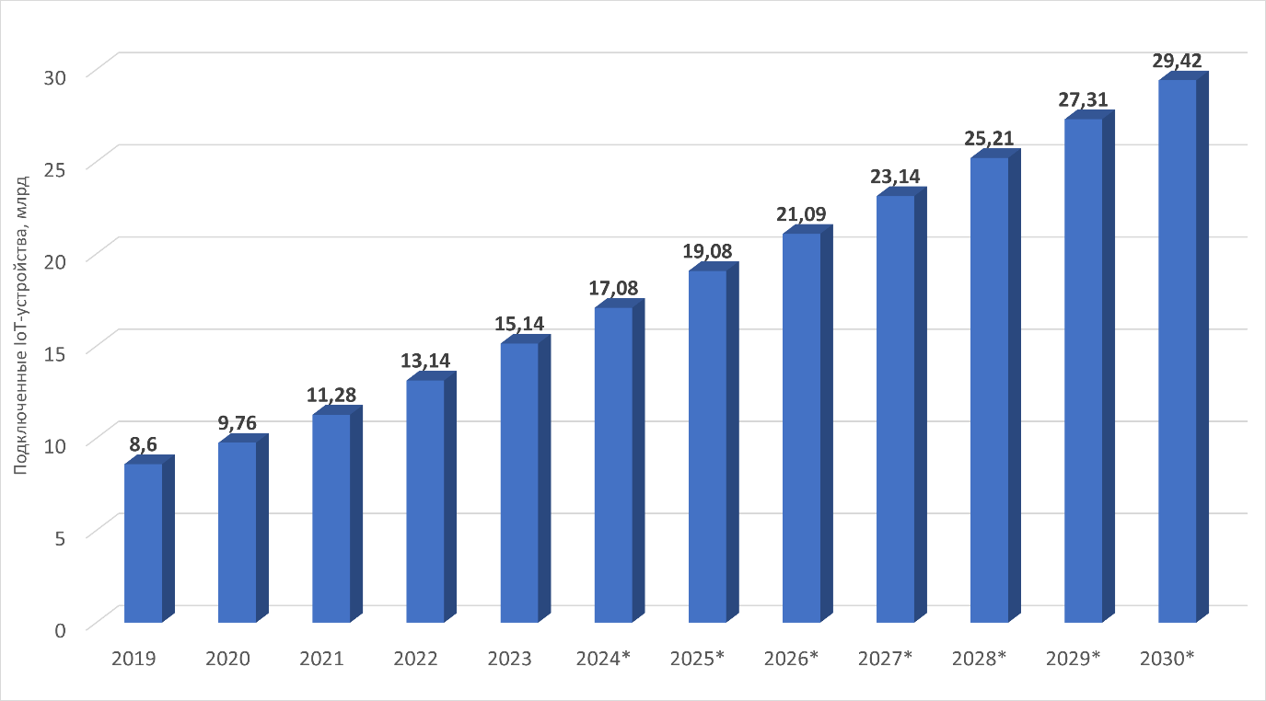
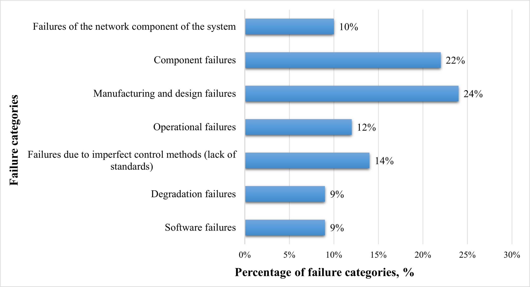
Relevance
27th International Conference on Distributed Computer and Communication Networks: Control, Computation, Communications
Computer and Communication Networks: Architecture, Protocols and Technologies
Development of a Multifactor Forecasting Method for Dependability Measures of IIoT‐Systems
/ 19
Fig. 1 – Growing number of IoT devices in the world
in 2019-2030
Fig. 2 – Classification and statistics of failures of electronic means according to the
Quanterion Solutions Incorporated (QSI).

Slide 3
Relevance
27th International Conference on Distributed Computer and Communication Networks: Control, Computation, Communications
Computer and Communication Networks: Architecture, Protocols and Technologies
Development of a Multifactor Forecasting Method for Dependability Measures of IIoT‐Systems
/ 19
Design
Production
Results of computational assessment of reliability indicators
Real statistics of failures during operation
Statistics
Failure rate 1/h
The difference is several orders of magnitude
Calculation
Overrated dependability!
The target level of dependability is not achieved due to shortcomings in the strategy for ensuring it!

Slide 4
Aim
27th International Conference on Distributed Computer and Communication Networks: Control, Computation, Communications
Computer and Communication Networks: Architecture, Protocols and Technologies
Development of a Multifactor Forecasting Method for Dependability Measures of IIoT‐Systems
/ 19
To improve the accuracy of dependability assessments for IIoT systems by developing a refined multifactor method that takes into account their hardware, software, and network components
was
is proposed

Slide 5
Existing methods for assessing the dependability of IIoT systems
27th International Conference on Distributed Computer and Communication Networks: Control, Computation, Communications
Computer and Communication Networks: Architecture, Protocols and Technologies
Development of a Multifactor Forecasting Method for Dependability Measures of IIoT‐Systems
/ 19
«Dependability of ERI» 2006
$$λ_{EE}=K_{a}∗\sum_{j=1}^{m}{\sum_{i=1}^{n}{λ_{эij}}}$$
$λ_{EE}$ – total failure rate of electronic equipment (EE)
$K_{a}$ – production quality factor of EE
$λ_{эij}$ – failure rate of the 𝑖-th type of products of the 𝑗-th group
$n$ – number of products of the 𝑗-th group
$m$ – number of product groups
$K_{a}$ = 1 according to military standards "Moroz-6" and "Climate-8"
$K_{a}$ = 0,2 according to the provisions of RK-98

Slide 6
Existing methods for assessing the dependability of IIoT systems
27th International Conference on Distributed Computer and Communication Networks: Control, Computation, Communications
Computer and Communication Networks: Architecture, Protocols and Technologies
Development of a Multifactor Forecasting Method for Dependability Measures of IIoT‐Systems
/ 19
Slavko J. Pokorni
$$R_{system}=R_{hard}\left(t\right)∗R_{soft}\left(t\right)∗R_{human}\left(t\right)$$
$R_{system}$ – dependability of the IIoT system as a whole
$R_{hard}\left(t\right)$ – hardware dependability
$R_{soft}\left(t\right)$ – software dependability
$R_{human}\left(t\right)$ – human factor dependability

Slide 7
Existing methods for assessing the dependability of IIoT systems
27th International Conference on Distributed Computer and Communication Networks: Control, Computation, Communications
Computer and Communication Networks: Architecture, Protocols and Technologies
Development of a Multifactor Forecasting Method for Dependability Measures of IIoT‐Systems
/ 19
Slavko J. Pokorni
$$F_{HF}={AP}_{HF}−{RP}_{HF}=1−\frac{K_{T\left(f\right)}}{1000}$$
$$λ_{p}=λ_{b}∗{π_{Q}∗π}_{T}∗π_{S}∗π_{A}∗π_{E}∗π_{R}∗π_{C}$$
$λ_{p}$ – product failure rate
$λ_{b}$ – basic failure rate of a product taking into account the influence of electrical and temperature loads
$π_{i}$ – coefficients that take into account various factors (environment, quality, etc.) that affect the dependability of the product
$F_{HF}$ – human factor dependability
${AP}_{HF}$ – actual probability of an employee completing tasks without causing harm to health
${RP}_{HF}$ – the required probability of an employee completing tasks without causing harm to health
$K_{T(f)}$ – injury rate, which is calculated by the enterprise using the expert assessment method depending on the level of competence of the employee

Slide 8
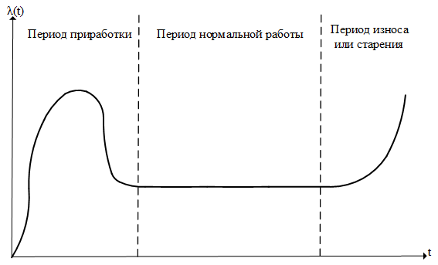
Models for assessing the dependability of system hardware
27th International Conference on Distributed Computer and Communication Networks: Control, Computation, Communications
Computer and Communication Networks: Architecture, Protocols and Technologies
Development of a Multifactor Forecasting Method for Dependability Measures of IIoT‐Systems
/ 19
Exponential distribution law
$$λ\left(t\right)=λ=const$$
$$T_{0}=\frac{1}{λ}$$
$$P\left(t\right)=e^{−\int_{0}^{t}{λdt}}=e^{−λt}$$
$$K_{Г}=\frac{T_{0}}{T_{0}+T_{В}}$$
running-in period
period of normal operation
period of wear and tear
$λ$ – failure rate
$T_{0}$ – operating time to failure
$P\left(t\right)$ – reliability function
$K_{Г}$ – availability factor
$T_{В}$ – restoration time
Fig. 3 – Failure rate of the object over time

Slide 9
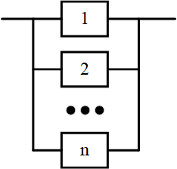
Models for assessing the dependability of system hardware
27th International Conference on Distributed Computer and Communication Networks: Control, Computation, Communications
Computer and Communication Networks: Architecture, Protocols and Technologies
Development of a Multifactor Forecasting Method for Dependability Measures of IIoT‐Systems
/ 19
Connection of elements
Fig. 5 – Parallel connection of elements
Fig. 4 – Series connection of elements
$$К_{Г}=1−\prod_{i=1}^{n}{\left(1−К_{Г_{i}}\right)}; P\left(t\right)=\prod_{i=1}^{n}{{(1−P}_{i}(t))}$$
$$T_{0}=\frac{\prod_{i=1}^{n}{(1+λ_{i}∗T_{В_{i}})}−\prod_{i=1}^{n}{(λ_{i}∗T_{В_{i}})}}{\sum_{i=1}^{n}{\frac{1}{T_{В_{i}}}}∗\prod_{i=1}^{n}{(λ_{i}∙T_{В_{i}})}}$$
$$T_{В}=\frac{1}{\sum_{i=1}^{n}{T_{В_{i}}}} ; λ=\frac{1}{T_{0}}$$
$$P\left(t\right)=\prod_{i=1}^{n}{P_{i}(t)}; T_{0}=\frac{1}{\sum_{i=1}^{n}{\frac{1}{T_{0_{i}}}}}; λ=\sum_{i=1}^{n}{λ_{i}}$$
$$К_{Г}=\prod_{i=1}^{n}{К_{Г_{i}}}; T_{В}=T_{0}∗\frac{1−К_{Г}}{К_{Г}}$$
$P_{i}(t)$, $T_{0_{i}}$, $λ_{i}$, $К_{Г_{i}}$, $T_{В_{i}}$ – reliability function, operating time to failure, failure rate, availability factor, restoration time of the 𝑖-th element of the system; $n$ – number of elements in the system

Slide 10
Models for assessing the dependability of system software
27th International Conference on Distributed Computer and Communication Networks: Control, Computation, Communications
Computer and Communication Networks: Architecture, Protocols and Technologies
Development of a Multifactor Forecasting Method for Dependability Measures of IIoT‐Systems
/ 19
Jelinski-Moranda model
$$λ=C_{D}∗\left(N−(k−1)\right)$$
$$C_{D}=\frac{\sum_{i=1}^{k−1}{\frac{1}{N−i+1}}}{\sum_{i=1}^{k−1}{t_{i}}}$$
$\left(k−1\right)∗\frac{\sum_{i=1}^{k−1}{t_{i}}}{\sum_{i=1}^{k−1}{\frac{1}{N−i+1}}}=\sum_{i=1}^{k−1}{\left(N−i+1\right)∗t_{i}}$
$λ_{i}$ – software failure rate
$C_{D}$ – proportionality factor
$N$ – initial number of program errors
$k$ – number of the predicted failure
$i$ – sequential number of the failure
$t_{i}$ – time of uninterrupted operation before the i-th failure

Slide 11
Models for assessing the reliability of the network part of systems
27th International Conference on Distributed Computer and Communication Networks: Control, Computation, Communications
Computer and Communication Networks: Architecture, Protocols and Technologies
Development of a Multifactor Forecasting Method for Dependability Measures of IIoT‐Systems
/ 19
Mesh topology
Fig. 6 – The process of dividing a mesh network into subnets

Slide 12
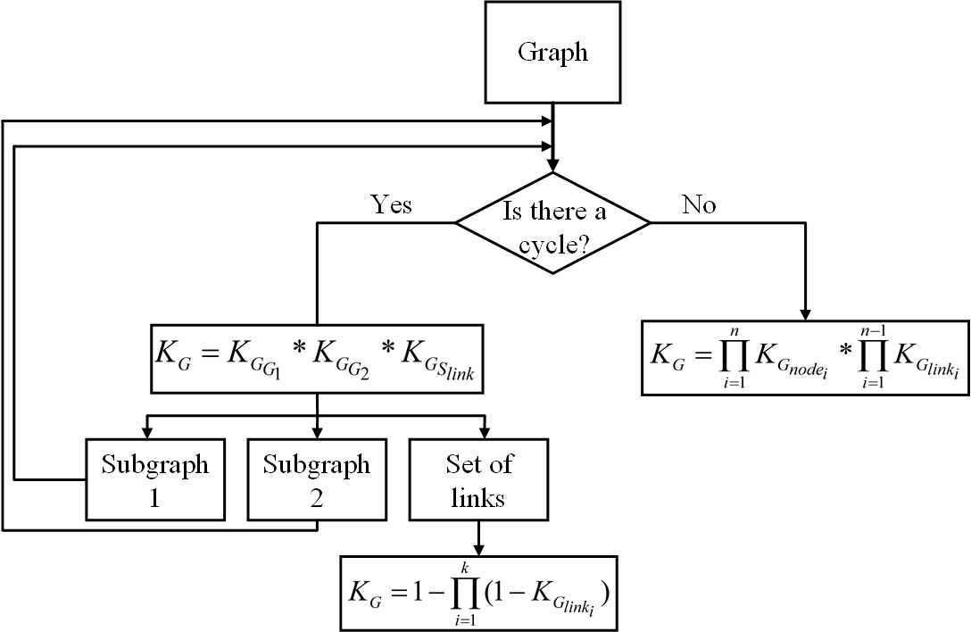
Models for assessing the reliability of the network part of systems
27th International Conference on Distributed Computer and Communication Networks: Control, Computation, Communications
Computer and Communication Networks: Architecture, Protocols and Technologies
Development of a Multifactor Forecasting Method for Dependability Measures of IIoT‐Systems
/ 19
$$K_{G_{node/link}}=1−\frac{T_{В}∗(L−1)}{T−T_{В}∗L}$$
Mesh topology
$K_{Г_{G_{1}}}$, $K_{Г_{G_{2}}}$– availability factors of the first and second subgraphs
$K_{Г_{S_{link}}}$– link set availability factor
$n$ – number of nodes in the graph
$k$ – number of links in the link set
$K_{Г_{node/link}}$ – availability factor of the node or link
$T_{В}$ – mean restoration time of the node or link after a failure
$L$ – number of failures of the node or link
$T$ – operating time of the node or link
1)
2)
Fig. 7 – Block diagram of the developed decomposition algorithm for dependability assessment

Slide 13
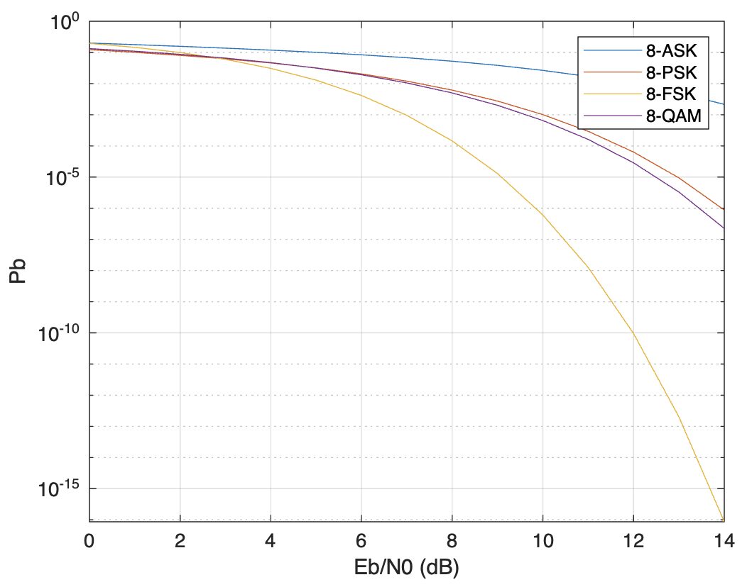
Models for assessing the reliability of the network part of systems
27th International Conference on Distributed Computer and Communication Networks: Control, Computation, Communications
Computer and Communication Networks: Architecture, Protocols and Technologies
Development of a Multifactor Forecasting Method for Dependability Measures of IIoT‐Systems
/ 19
Bit error probability (QAM)
$$P_{B}=\frac{2∗P_{0}−P_{0}^{2}}{\log_{2}{M}}$$
$$P_{0}=\frac{2∗(\sqrt{M}−1)}{\sqrt{M}}∗Q\left(\sqrt{\frac{3∗\log_{2}{M}}{M−1}∗\frac{E_{b}}{N_{0}}}\right)$$
$P_{B}$ – bit error probability
$M$ – modulation level
$Q\left(x\right)=\frac{1}{\sqrt{2π}}\int_{x}^{∞}{exp\left(−\frac{y^{2}}{2}\right)dy}$ – error integral
$\frac{E_{b}}{N_{0}}$ – signal-to-noise ratio (SNR)
Fig. 8 – Bit error probability for various types of modulation

Slide 14
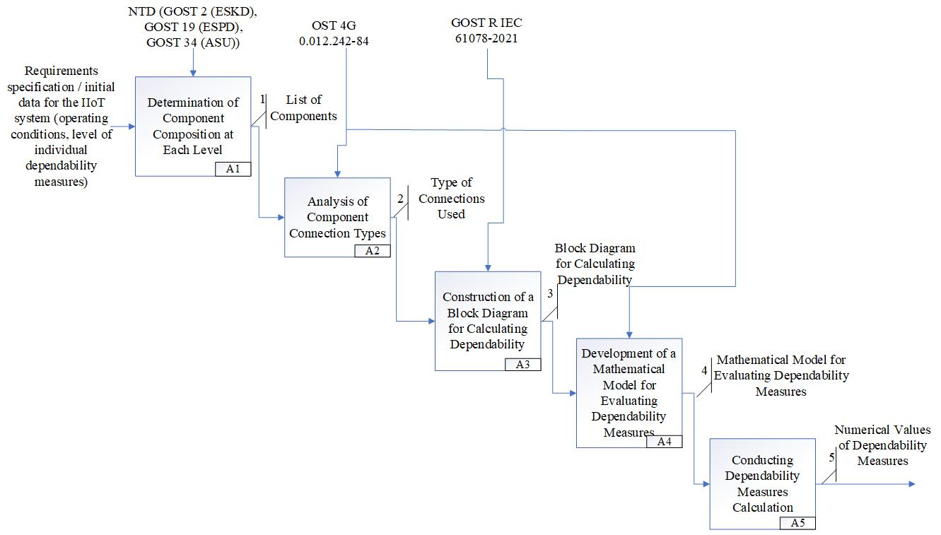
27th International Conference on Distributed Computer and Communication Networks: Control, Computation, Communications
Computer and Communication Networks: Architecture, Protocols and Technologies
Development of a Multifactor Forecasting Method for Dependability Measures of IIoT‐Systems
/ 19
Existing approach to assessing the dependability of IIoT systems
Fig. 9 – IDEF0 diagram of the existing approach to assessing the dependability of an IIoT system

Slide 15
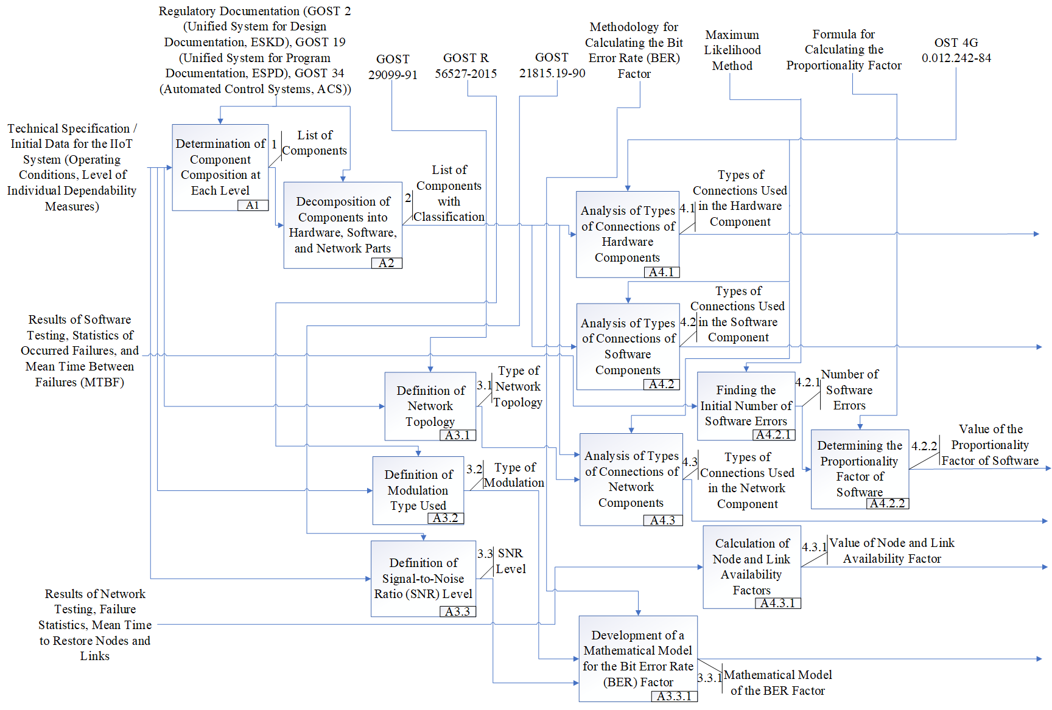
Refined approach to assessing the dependability of IIoT systems
27th International Conference on Distributed Computer and Communication Networks: Control, Computation, Communications
Computer and Communication Networks: Architecture, Protocols and Technologies
Development of a Multifactor Forecasting Method for Dependability Measures of IIoT‐Systems
/ 19
Fig. 10 – IDEF0 diagram of the developed approach to assessing the dependability of an IIoT system (Part 1)

Slide 16
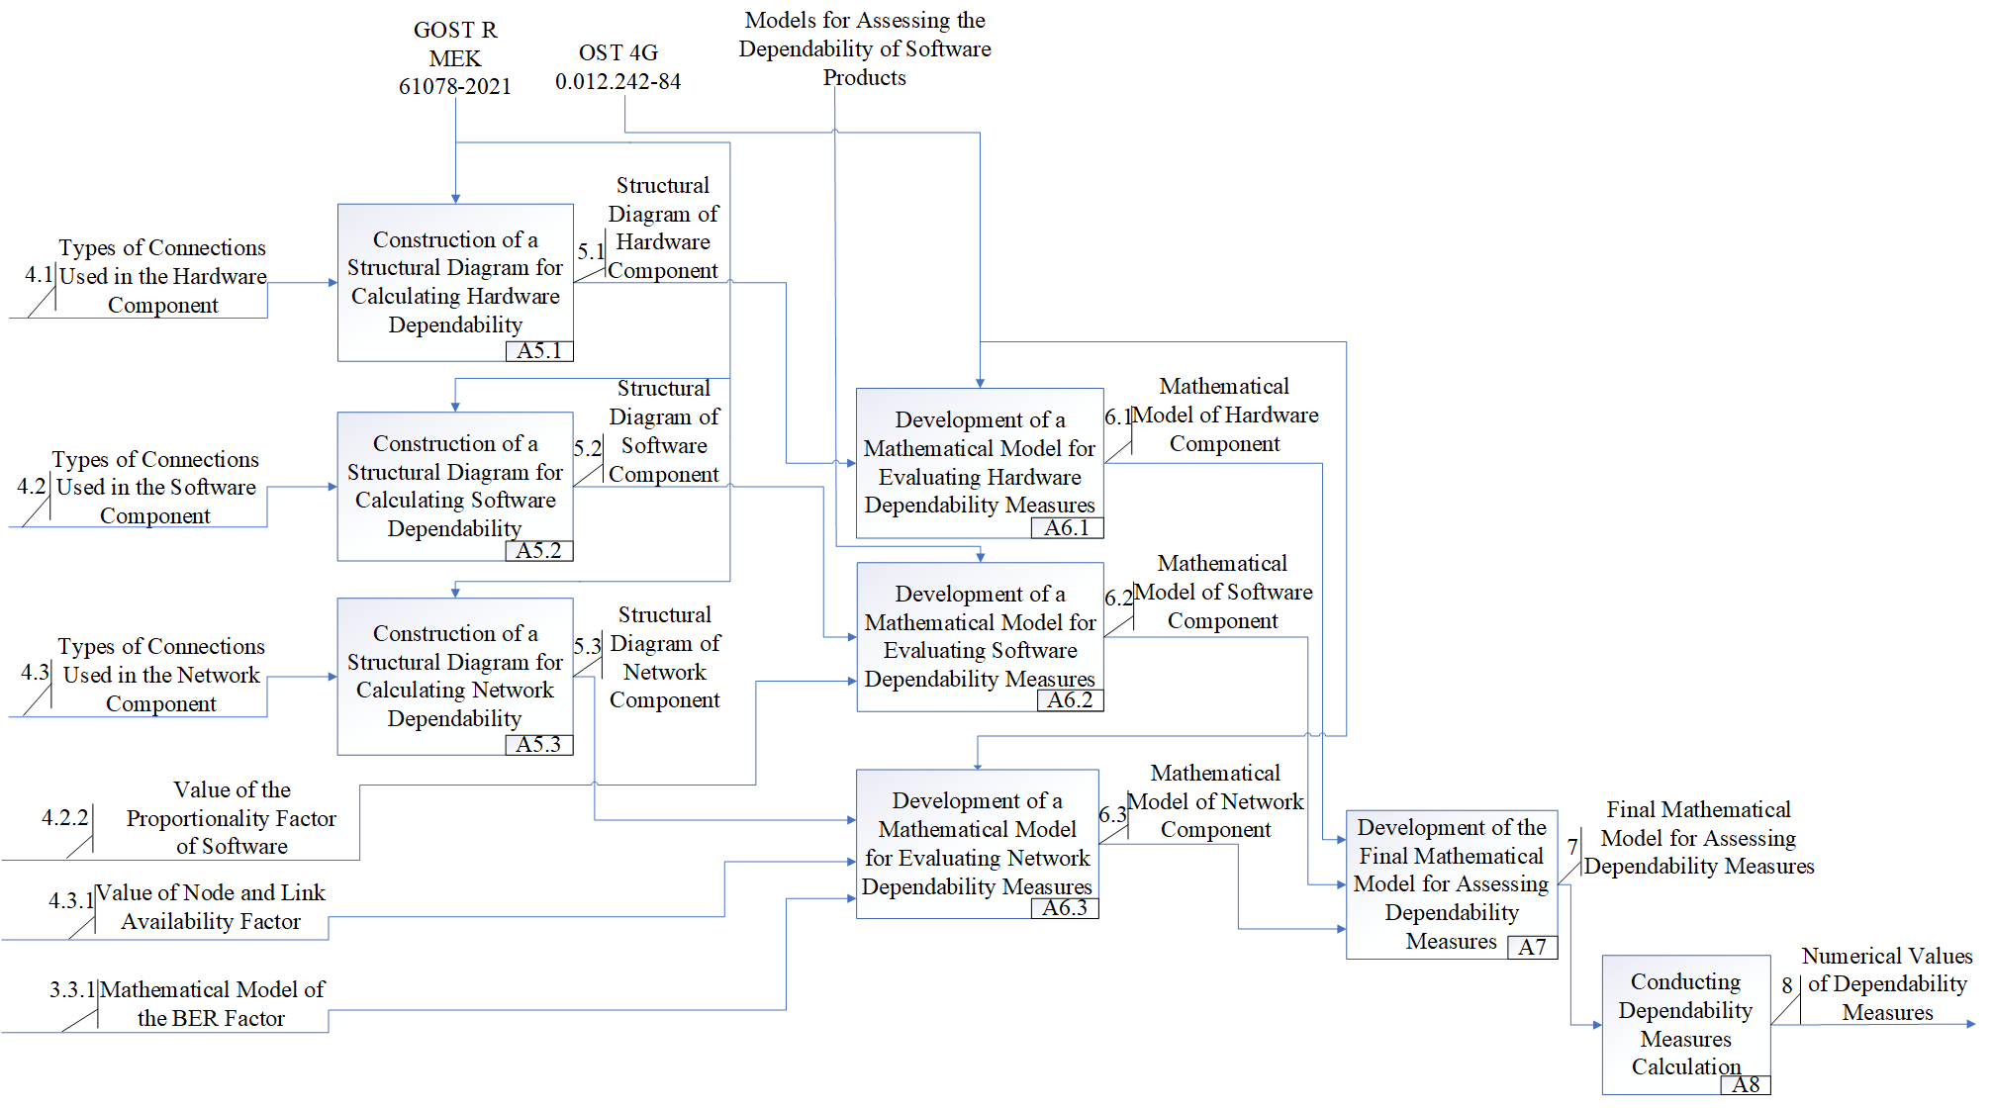
Refined approach to assessing the dependability of IIoT systems
27th International Conference on Distributed Computer and Communication Networks: Control, Computation, Communications
Computer and Communication Networks: Architecture, Protocols and Technologies
Development of a Multifactor Forecasting Method for Dependability Measures of IIoT‐Systems
/ 19
Fig. 11 – IDEF0 diagram of the developed approach to assessing the dependability of an IIoT system (Part 2)

Slide 17
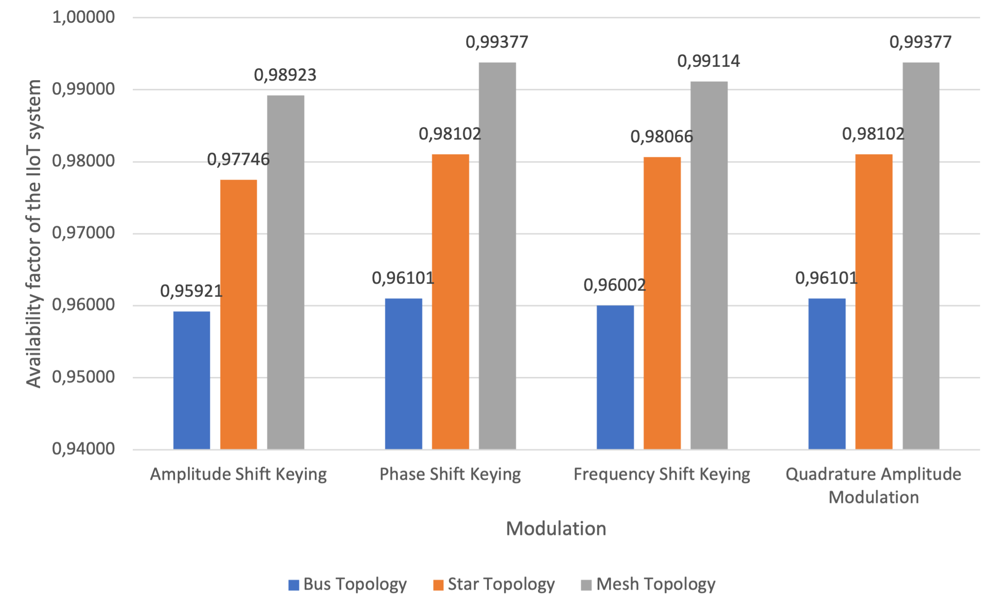
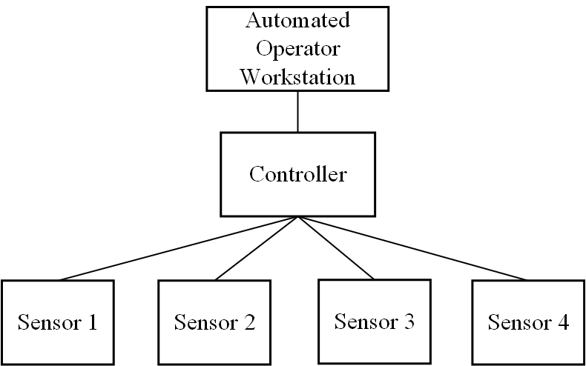
Calculation of the availability factor of an IIoT system
27th International Conference on Distributed Computer and Communication Networks: Control, Computation, Communications
Computer and Communication Networks: Architecture, Protocols and Technologies
Development of a Multifactor Forecasting Method for Dependability Measures of IIoT‐Systems
/ 19
IIoT-system
Fig. 12 – Availability factors for IIoT system with different topologies and modulations

Slide 18
Conclusion
27th International Conference on Distributed Computer and Communication Networks: Control, Computation, Communications
Computer and Communication Networks: Architecture, Protocols and Technologies
Development of a Multifactor Forecasting Method for Dependability Measures of IIoT‐Systems
/ 19
A literature review of approaches used in practice was conducted to assess the dependability of the entire IIoT system;
Mathematical methods for evaluating software, technical components and the network part of the system have been studied;
A multifactor refined approach to predicting the dependability of an IIoT system has been developed;
An IDEF0 diagram of the developed approach has been constructed.

Slide 19
Development of a Multifactor Forecasting Method for Dependability Measures of IIoT‐Systems
27th International Conference on Distributed Computer and Communication Networks: Control, Computation, Communications
Computer and Communication Networks: Architecture, Protocols and Technologies
RUDN University, Moscow, Russia
Authors: Viacheslav Tsvetkov, student, HSE University
Sergey Polesskiy, Candidate of Technical Sciences, HSE University
Pavel Korolev, Candidate of Technical Sciences, HSE University
Leonid Lander, student, HSE University

