Slide 1
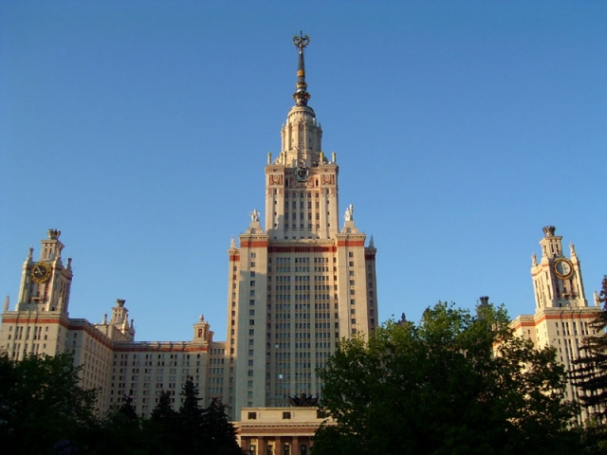
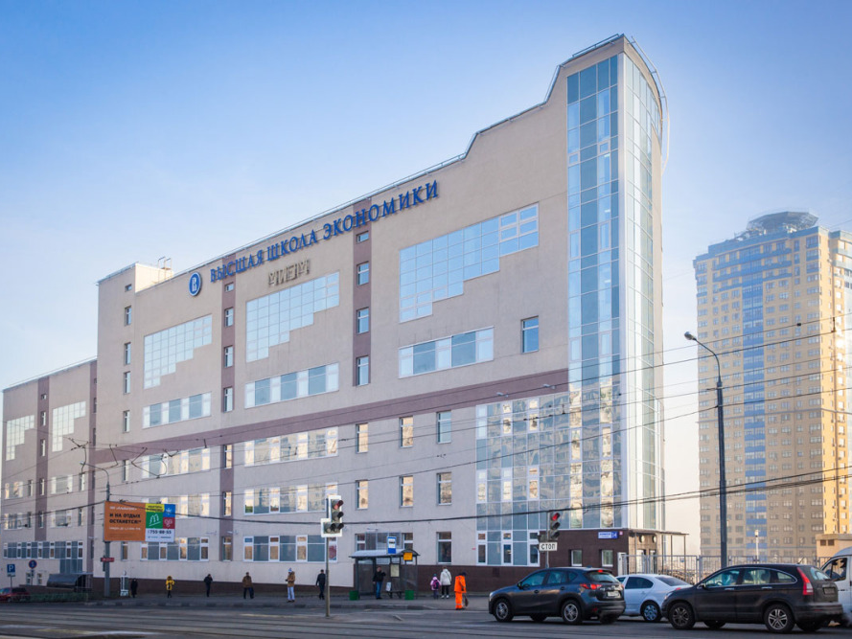
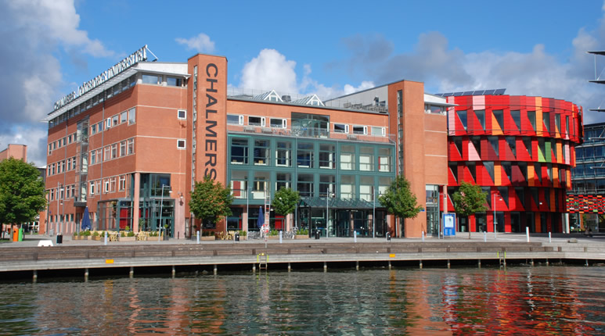
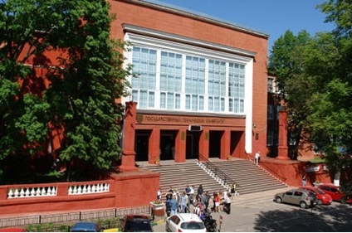
N. Pugach
Lomonosov Moscow State University
National Research University
Higher School of economics
Spin amplification of electron cooling in cold-electron bolometers due to suppression of Andreev reflection by magnetic impurities
Vasenko
A. Gordeeva
L. Pankratov
L.S. Kuzmin
Chalmers University of Technology, Sweden
Alekseev Nizhny Novgorod
State Technical University

Slide 3
Finite temperature provides the smooth
equilibrium distribution

Slide 4
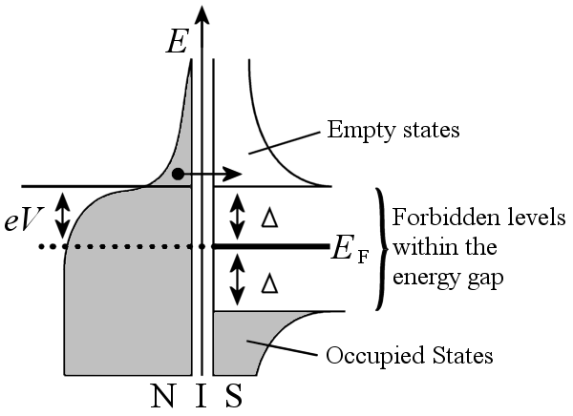
SIN cooling
Hot electrons flow from N layer to S electrode above gap. Cold electrons are
locked by the spectrum gap in S. The same is for holes.
Cooling power:
Fermi distribution

Slide 6
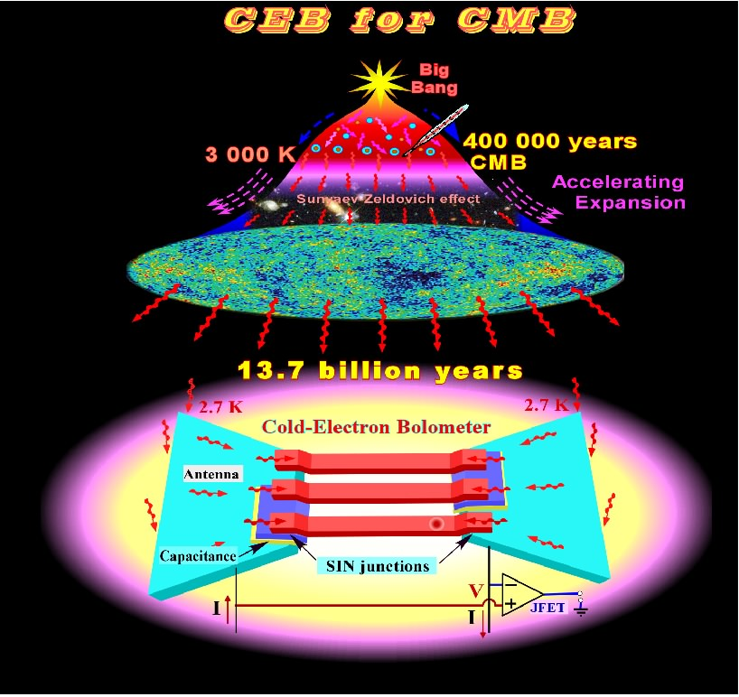
C
O
L
D
E
L
E
C
T
R
O
N
B
O
L
O
M
E
T
E
R
(CEB)

Slide 7
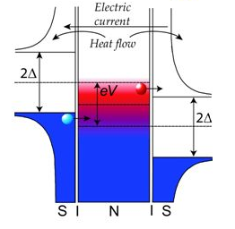

SINIS junction
Tunnel current through SIN (SINIS) junction:
SINIS junction
Cooling power doubles
How to increase SINIS cooling?

Slide 8
Some limitations of SIN electron cooling
The solution may be use of electron trap

Slide 9
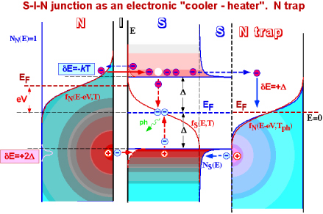
1) Use SIN cooling with electrons trap
Electrons trap N provides drainage and relaxation of hot electrons
from S electrodes, and therefore, more equilibrium

Slide 10
2) Improve geometry
A - SEM image of the design with one stock and with normal metal traps.
C - SEM image of the design with two stocks and normal traps for hot electrons.

Slide 11
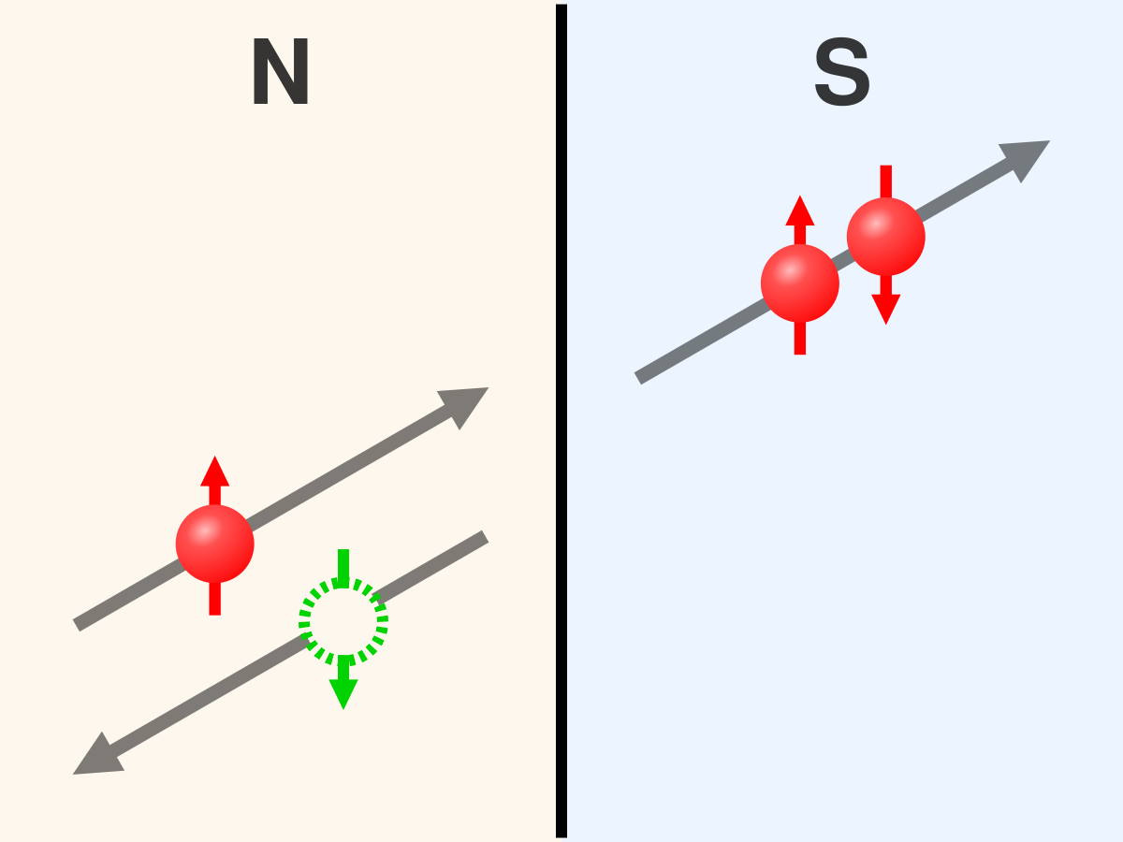
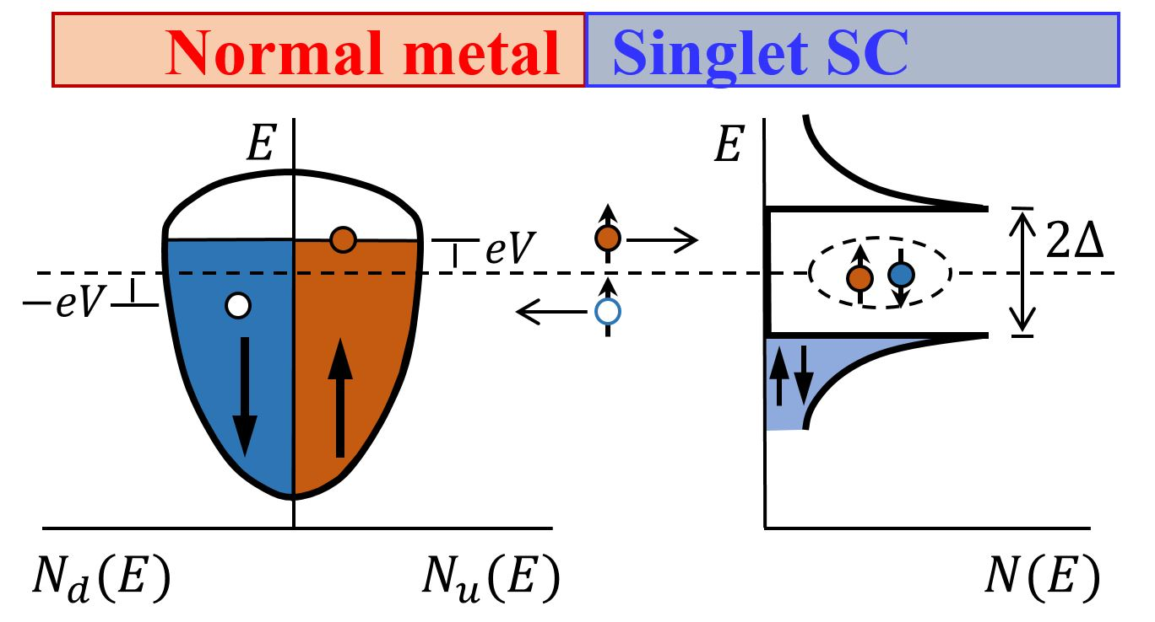
3) To suppress Andreev reflection
Andreev reflection as two-particle under gap process limits SIN cooling
at low temperatures
I ~ I_{A}
Andreev current:

Slide 13
SFFN junction
S-FI-N junction

Slide 14
Magnetic scattering
Our colleagues used SINIS planar junction with iron
underlayer.
Iron provides the magnetic scattering, which destroys Cooper pairs, shortens the coherence length, and suppresses the Andreev reflection
We also take into account the planar geometry of the junction

Slide 15
Theoretical Model
Keldysh technique (initially),
Linearized Usadel Equations
Theta parametrization:

Slide 16
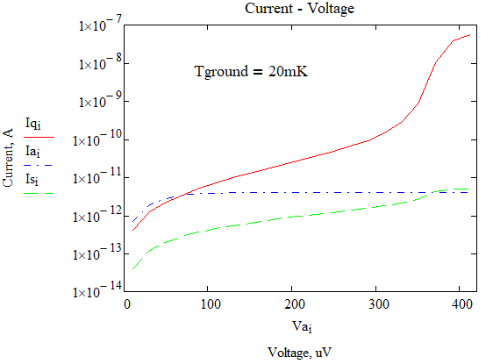
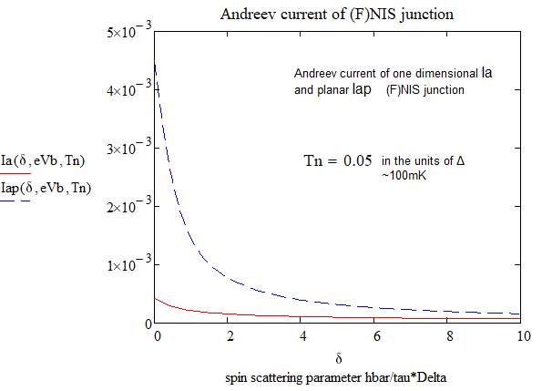
Suppression of Andreev reflection
Theoretical results
Exper.
Andreev
Andreev + scattr.
I_{q} – measured current, including quasiparticle one,
T_{e}(V) was extracted from experimental data
Andreev current suppression
by spin scattering is much better pronounced in the planar geometry

Slide 17
Magnetic scattering suppresses Andreev Reflection
(experimental results)
Experimental results: differential conductivity for samples A and C
at different temperatures
A characteristic feature of Andreev scattering is zero bias peak in the differential conductivity

Slide 18
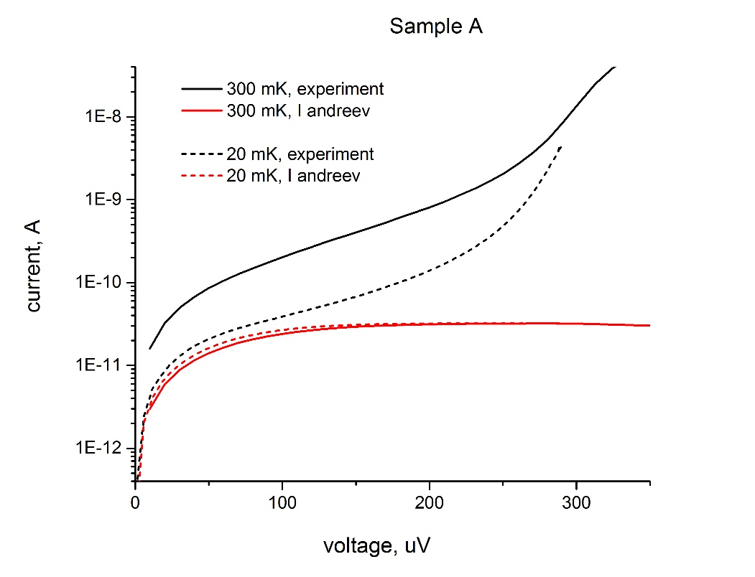
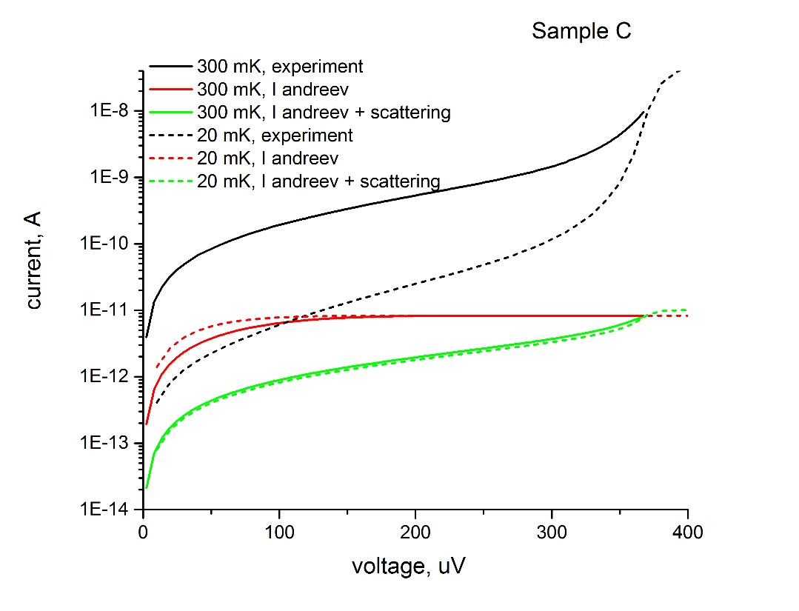
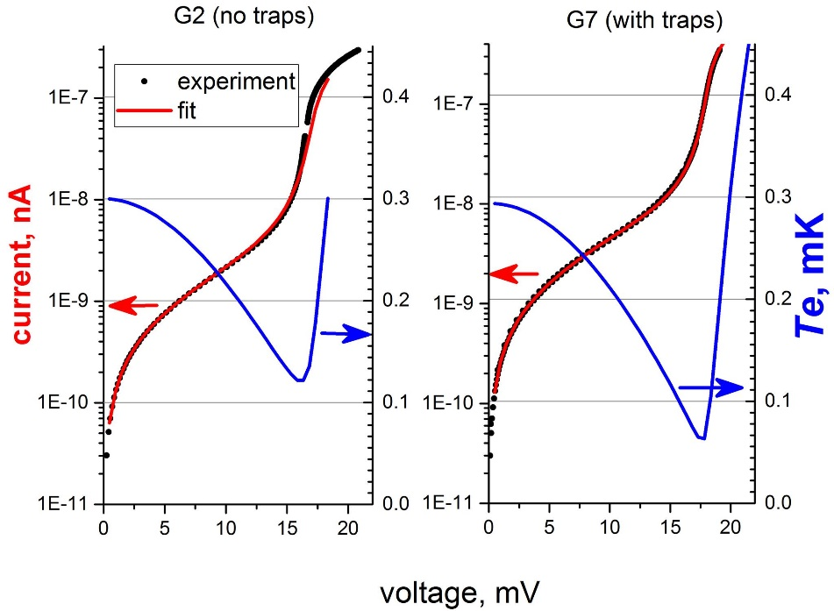
Experimental results
Electron temperature was extracted both:
From current measurements,
From heat-balance equation
Record cooling that we reached was
from ~170 mK to ~45 mK

Slide 19
This work was prepared within the framework of the Academic Fund Program at the National Research University Higher School of Economics (HSE) in 2019, grant “Exchange interactions in low-dimentional quantum magnetic systems” and by the Russian Academic Excellence Project "5-100".
Thank you for attention!

