Slide 1
Experimental Evaluation of Iridium Performance under Varying Weather Conditions and Elevation Angles
HSE Tikhonov Moscow Institute of Electronics and Mathematics
Dept. of Computer Engineering
Moscow 2024
Ilin Alexander, Alexey Matinyan,
Alexey Rolich, Leonid Voskov

Slide 2
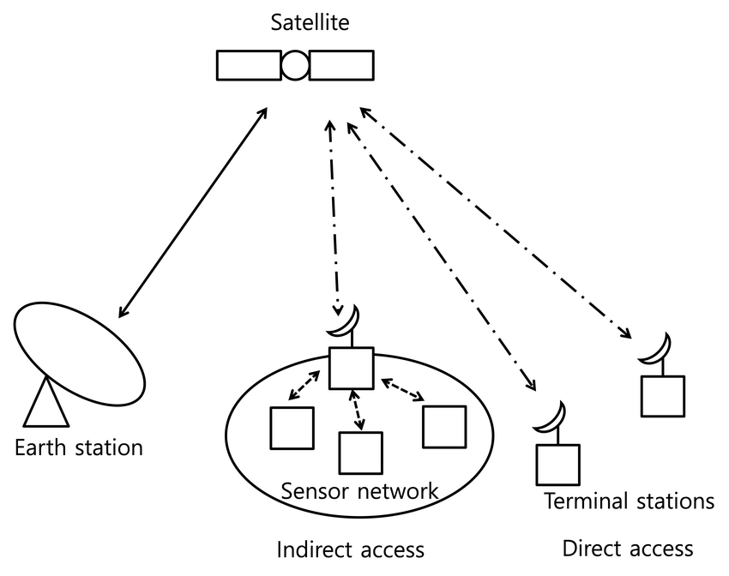
Satellite-enabled IoT
Satellite IoT expands the potential of traditional IoT, which relies on communication protocols like Wi-Fi, Bluetooth, LoRaWAN® and cellular networks
This is vital in remote or rural areas where land-based infrastructure is limited, unlocking a range of opportunities from real-time agricultural monitoring in isolated regions to maritime navigation.

Slide 3
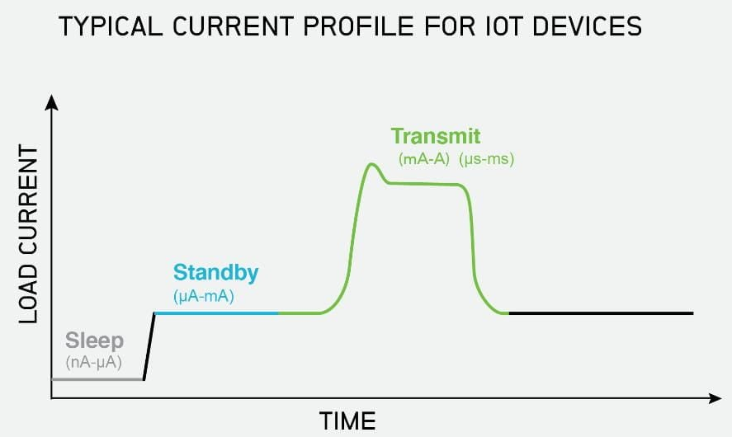
Communication module energy consumption
Reducing active operation time of the communication module can lead to significant improvement on overall battery life
Edge computing
Data compression
Ensuring high transmission success rate (to avoid making multiple attempts)

Slide 4
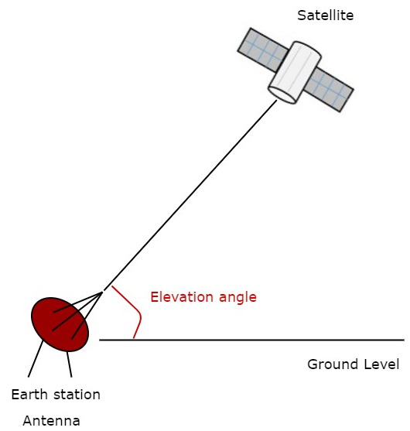
Elevation angle
Calculating satellite positions and generating optimal transmission schedules to reduce failed data transfers and minimize active system operation.
Algorithm for calculating satellites positions utilizes a special two-line format that encodes orbital elements of satellites (TLE data)

Slide 5
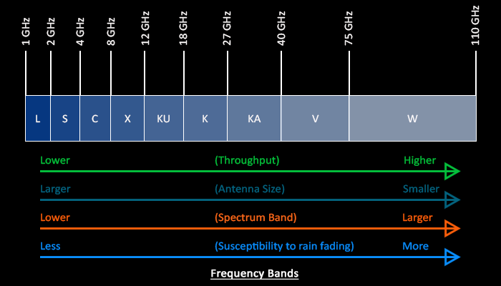
Atmospheric attenuation
Most of the solutions on the market for IoT applications use channels below 2GHz in their LEO satellite systems.
For example, satellite IoT startups like:
Astrocast, Kineis, Lacuna Space, Myriota, Swarm or global providers like Iridium.

Slide 6
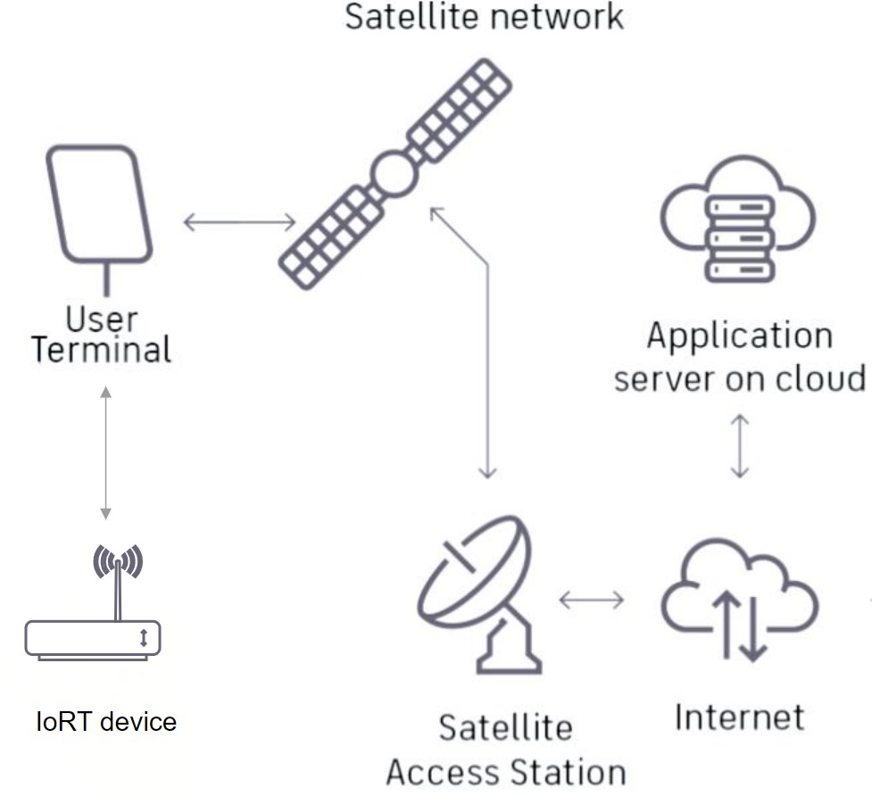
Experiment
The experiments were conducted on the premises of the HSE Tikhonov Moscow Institute of Electronics and Mathematics. Antenna was placed at favorable location on the roof of 9 story building. However minimal signal blockage and signal reflections could still occur for low elevation angels due to nearby building structures.

Slide 7
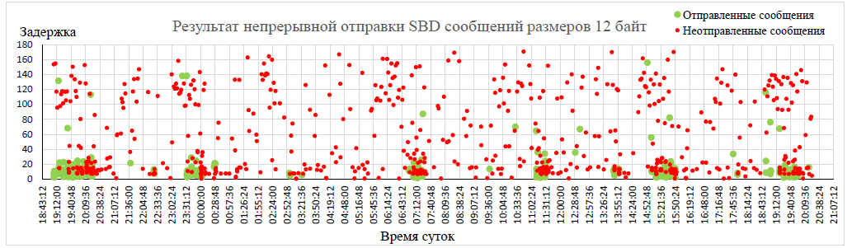
Transmission windows

Slide 8
Transmission success rate relevant to weather conditions
Weather status | Cloudiness, % | Rainfall, mm | Attempts | Success rate, %
Mainly clear | 28,03 | 0 | 6225 | 45,2
Partly cloudy | 64,11 | 0 | 13474 | 44,1
Overcast | 95,53 | 0 | 27087 | 33,8
Fog and depositing rime fog | 85,29 | 0 | 1731 | 25,7
Slight Rain | 97,44 | 0,22 | 3628 | 18,3
Rain showers: Slight, moderate, and violent | 99,83 | 0,33 | 3531 | 17,2
Thunderstorm: Slight or moderate | 100 | 0,38 | 2124 | 11,4
Thunderstorm with slight and heavy hail | 100 | 1,25 | 636 | 12,9

Slide 9
Multi-criteria choice
Demanded success rate can be achieved by combination of available satellites at favorable elevation angle and specific weather condition.
Weather status | success rate
N sats > 30 | 0 | 1 | 2 | 3 | 4
Mainly clear | 28,2% | 52,4% | 53,9% | 49,1% | 100%
Overcast | 21,0% | 39,4% | 44,3% | 42,6% | 44,7%
Partly cloudy | 30,6% | 50,2% | 52,9% | 53,3% | 100%
Rain: Slight, moderate, and violent | 11,7% | 21,1% | 19,0% | 20% | 50%

Slide 10
Delay time
Time from message generation to registration on the application server

