Slide 1
Perovskite nanoparticles
Synthesis and optical properties

Slide 2
Perovskite structure

Slide 3
Hot injection method
nanoparticles size control
monodisperse
special conditions
high temperature

Slide 4
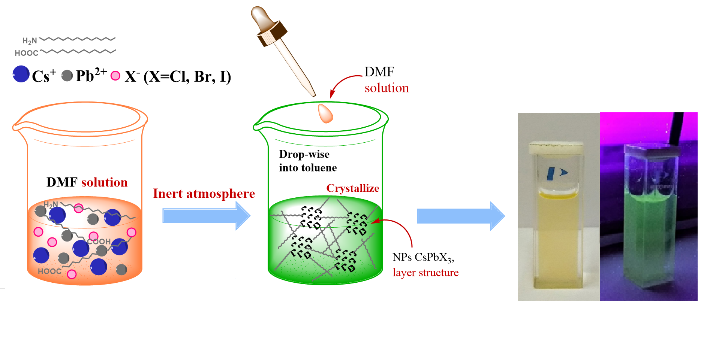
Alternative synthesis methods
Ultrasonic method
simplicity
room temperature
Antisolvent method
polydispersity
uncontrolled NPs size and structure

Slide 5
Perovskite structure
Sample | Point group | a, Å | β, ⁰ | Crystal size, nm
CsPbBr₃ | Pm-3m | 5.81 | 90 | 27.6 ± 5.2
CsPbCl_{3-z}Br_{z} | Pm-3m | 5.80 | 90 | 33.4 ± 8.9
CsPbCl₃ | Pm-3m | 5.69 | 90 | 14.5 ± 1.3
CsPb_{1-y}Mn_{y}Cl_{3-z}Br_{z} | Pm-3m | 5.69 | 90 | 17.1 ± 2.4
CsPb_{1-y}Mn_{y}Cl₃ | Pm-3m | 5.57 | 90 | 20.7 ± 3.9

Slide 6
NPs size, shape and the ratio of elements
Sample |  | Theoretical atomic ratio | Experimental atomic ratio
CsPbBr₃ |  | СsPbBr₃ | CsPb_{1.2}Br_{2.5}
CsPbCl_{3-z}Br_{z} |  | CsPbCl_{1.5}Br_{1.5} | Cs_{1.1}PbCl_{0.59}Br_{2.59}
CsPbCl₃ |  | CsPbCl₃ | CsPb_{1.3}Cl_{1.3}
CsPb_{1-y}Mn_{y}Cl_{3-z}Br_{z} |  | CsPb_{0.3}Mn_{0.7}Cl_{2.5}Br_{0.5} | CsPb_{1.2}Mn_{0.7}Cl_{2.5}Br_{2.2}
CsPb_{1-y}Mn_{y}Cl₃ |  | CsPb_{0.3}Mn_{0.7}Cl₃ | CsPb_{0.8}Mn_{0.7}Cl_{2,58}

Slide 7
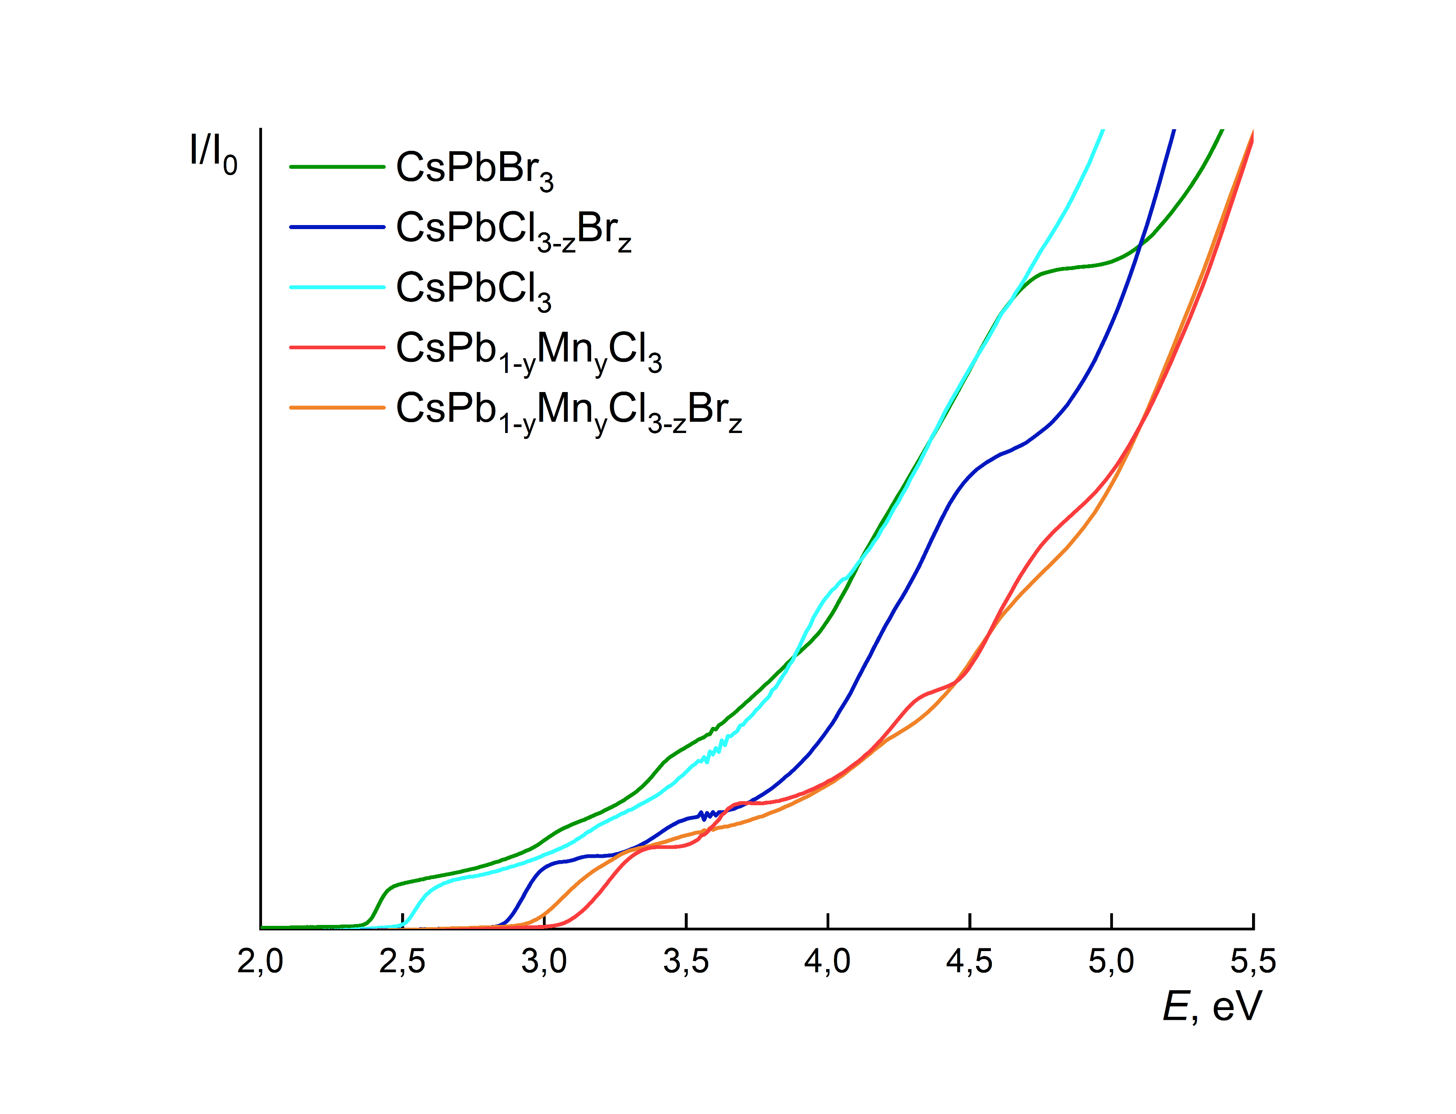
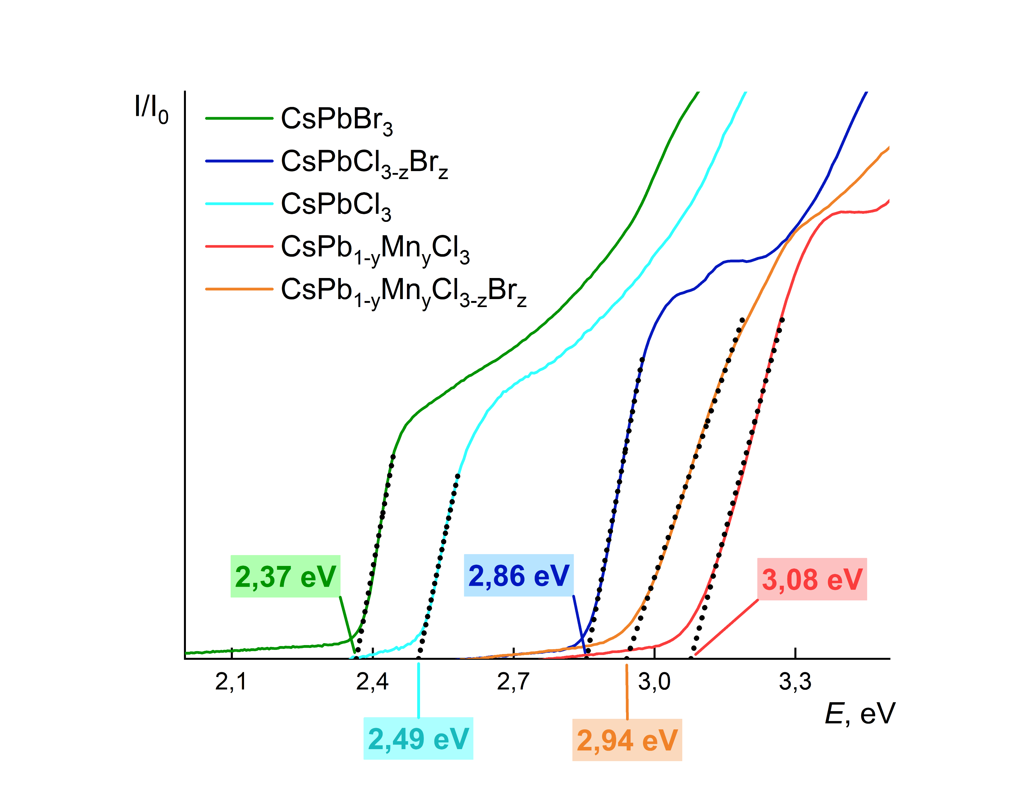
Optical properties
Emission spectra
Absorption spectra

Slide 8
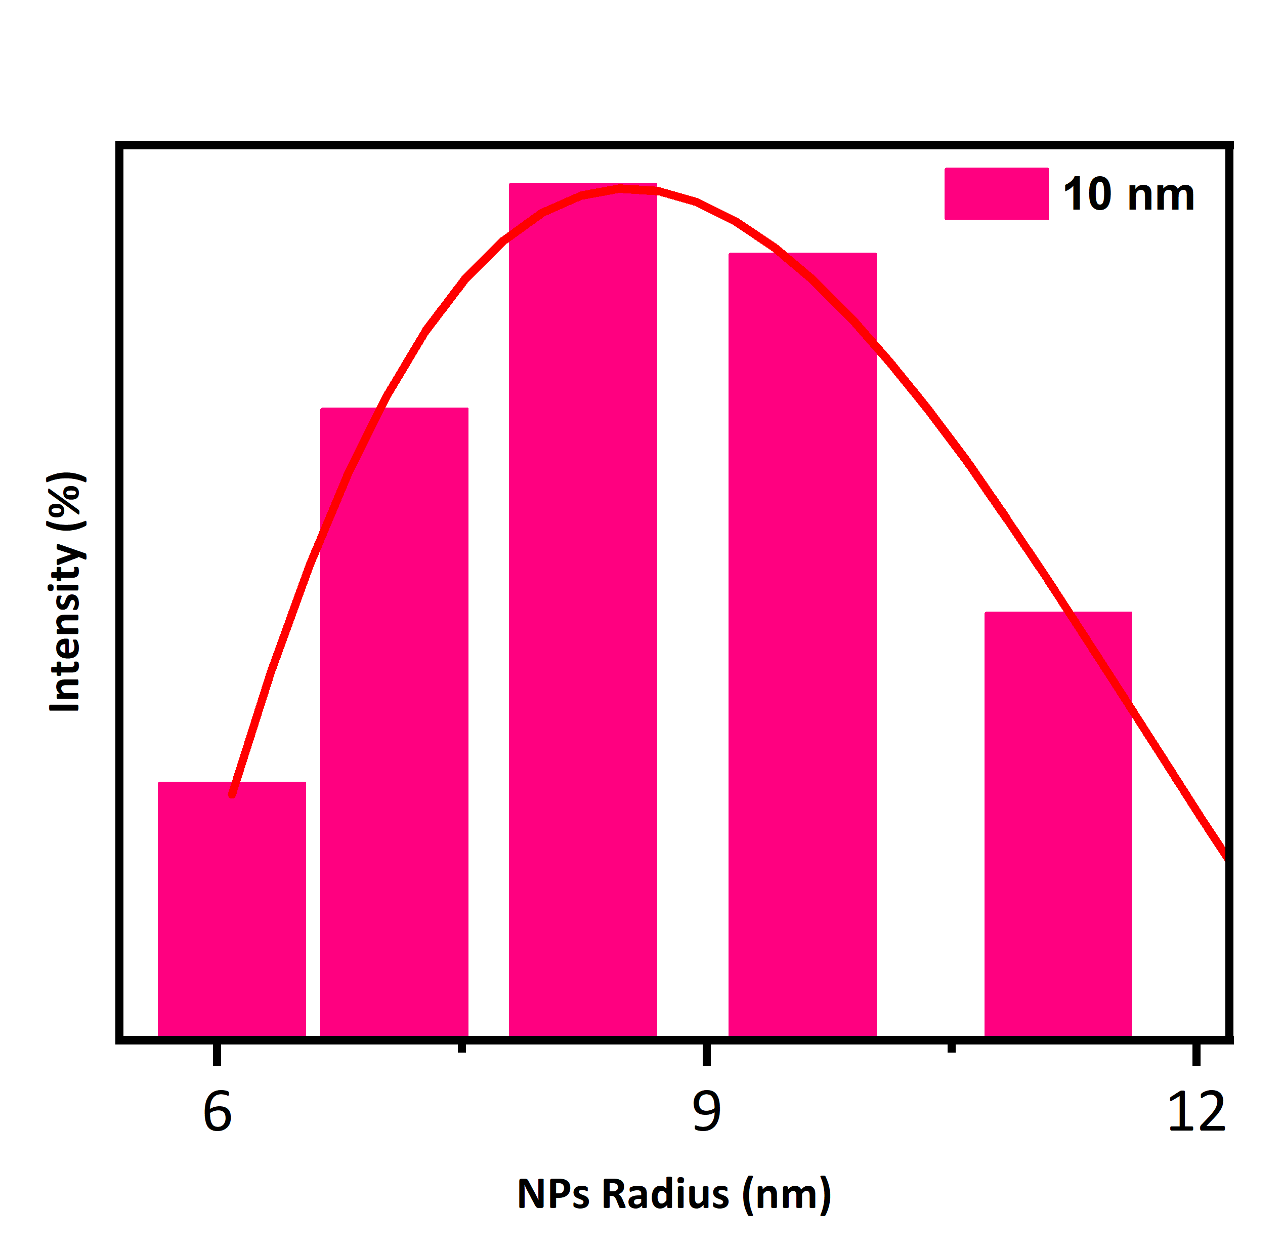
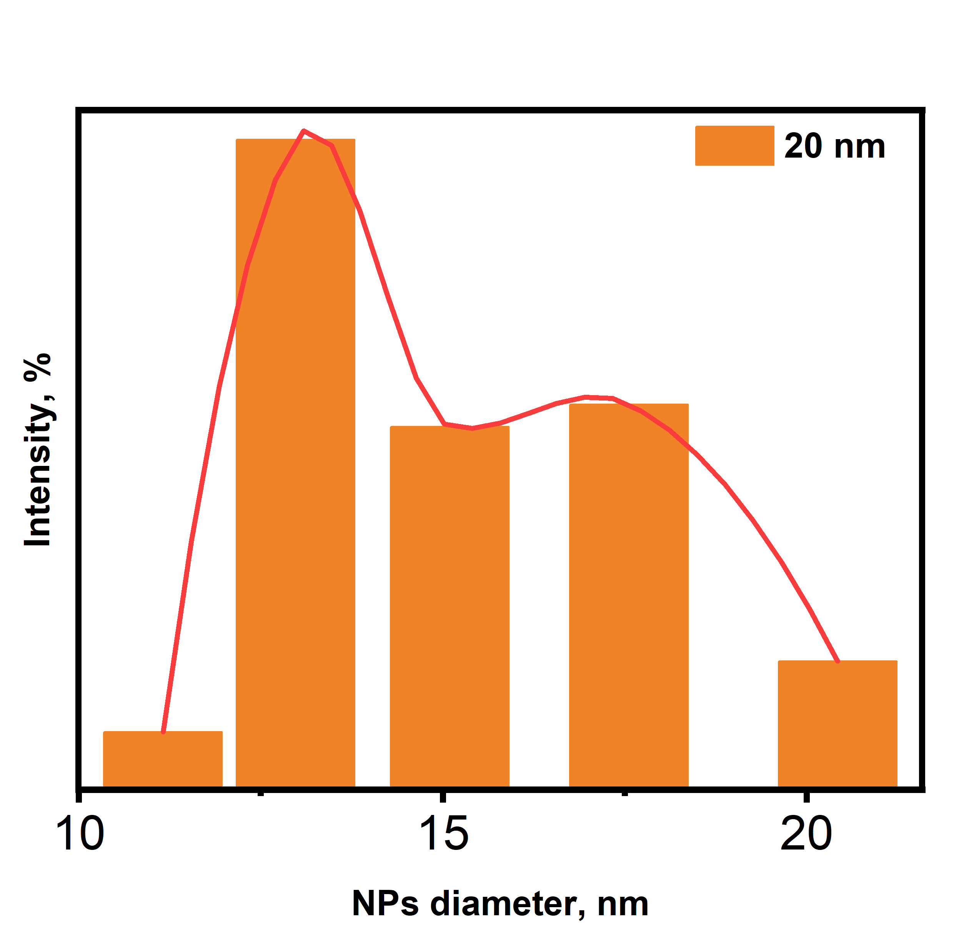
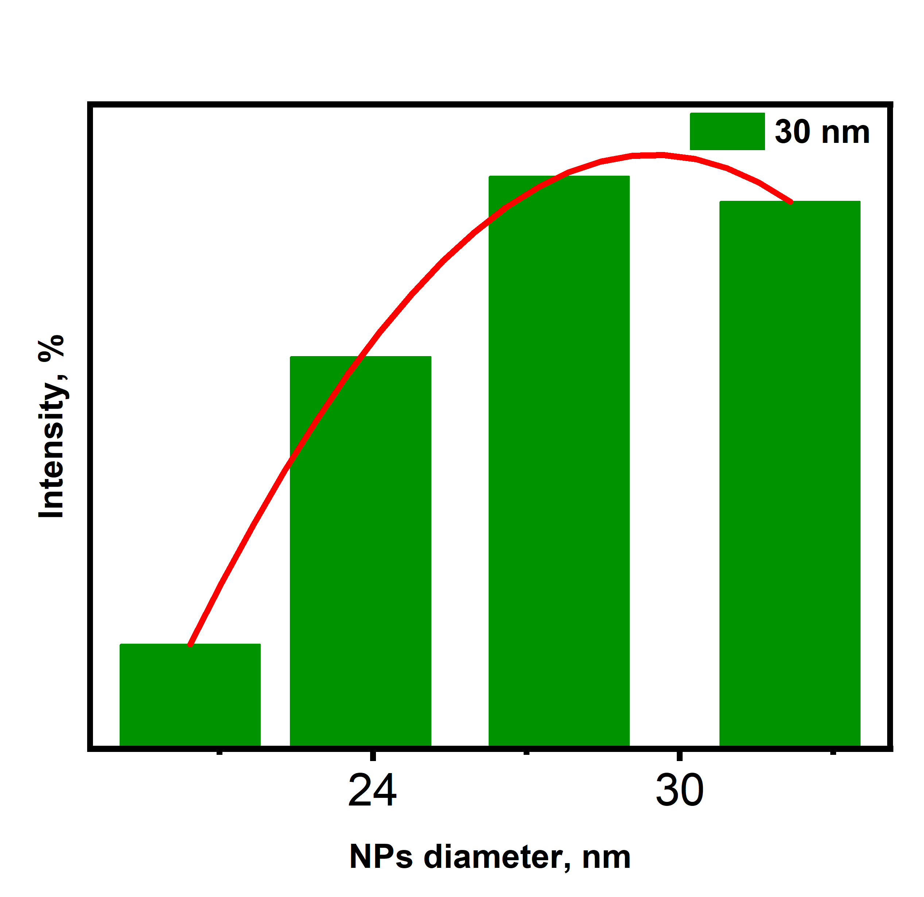
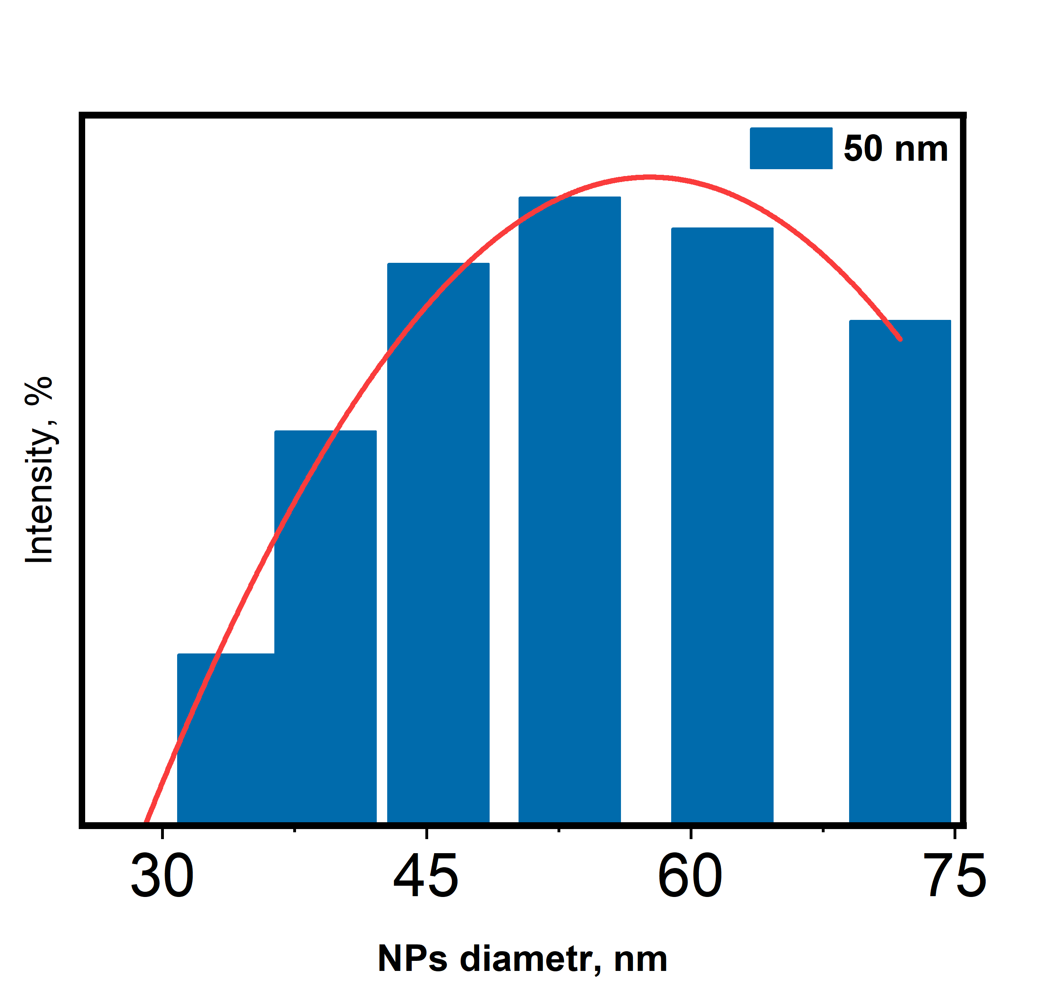
Size control
Emission spectra

Slide 9
CsPbBr₃ and Cs₄PbBr₆ perovskite
CsPbBr₃. Hot injection synthesis.
Cs₄PbBr₆. Ultrasonic method of synthesis.

Slide 10
CsPbBr₃ and Cs₄PbBr₆ perovskite

Slide 11
CsPbBr₃ and Cs₄PbBr₆ perovskite

Slide 12
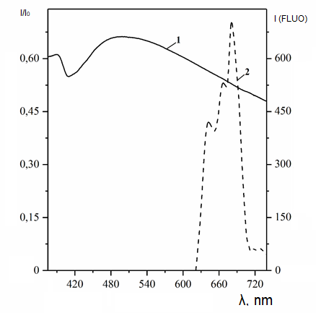
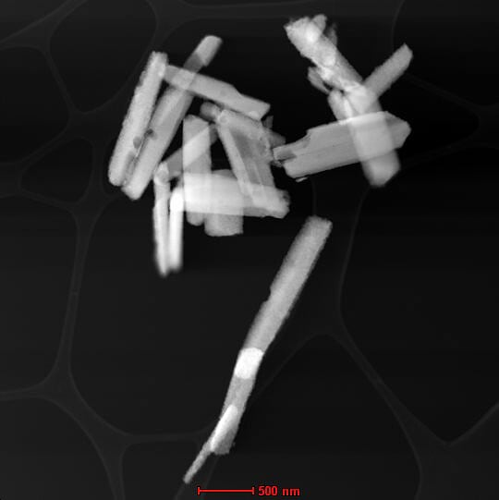
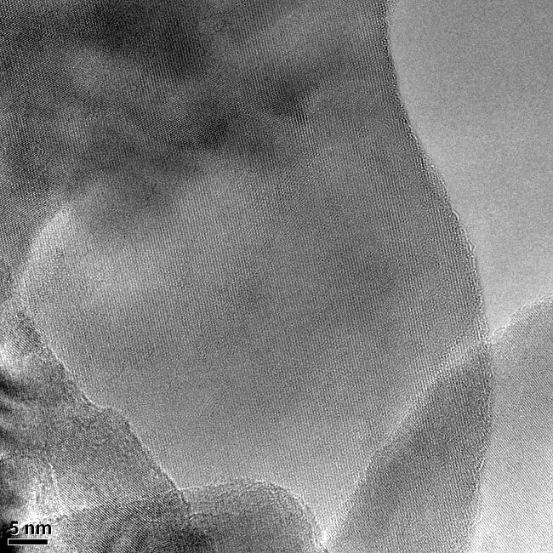
Alternative synthesis methods. Optical properties
Antisolvent method of synthesis
Absorption and emission spectra
NPs layer structure

