Slide 1
The effect of disorder on the band gap of double perovskite Cs₂AgBiBr₆

Slide 2
What are double perovskites?
double perovskites are considered a good replacement option for lead-based perovskites, since their structure is much more stable and harmless to nature, unlike lead.
2 Pb → Ag + Bi
Toxicity
Poor stability
…but high efficiency
Nontoxicity
Excellent stability
…but low efficiency

Slide 3
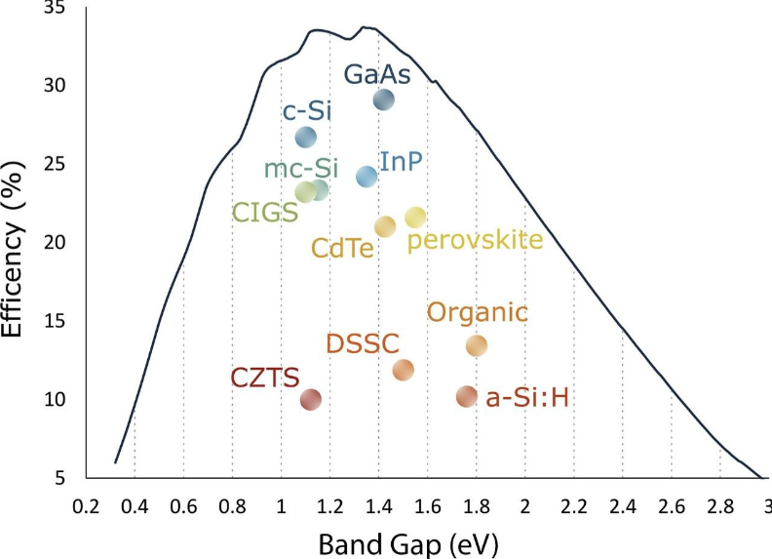
Introduction
A large band gap can absorb only a small amount of solar energy (the shortwave part), so its optimization will make the material more efficient and expand the absorption range, thus it becomes more promising for use in solar panels
Cs₂AgBiBr₆

Slide 4
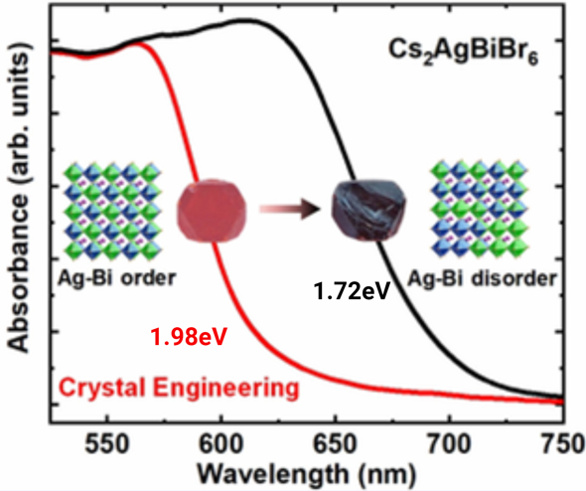
Background
It has been shown that due to the control of the crystal growth temperature, a significant narrowing of the band gap occurs. Further experiments revealed smaller band gap zones due to the order-disorder transition of Ag and Bi atoms under thermochromic conditions. However, the exact method is not exactly clear, which is what we’re researching

Slide 5
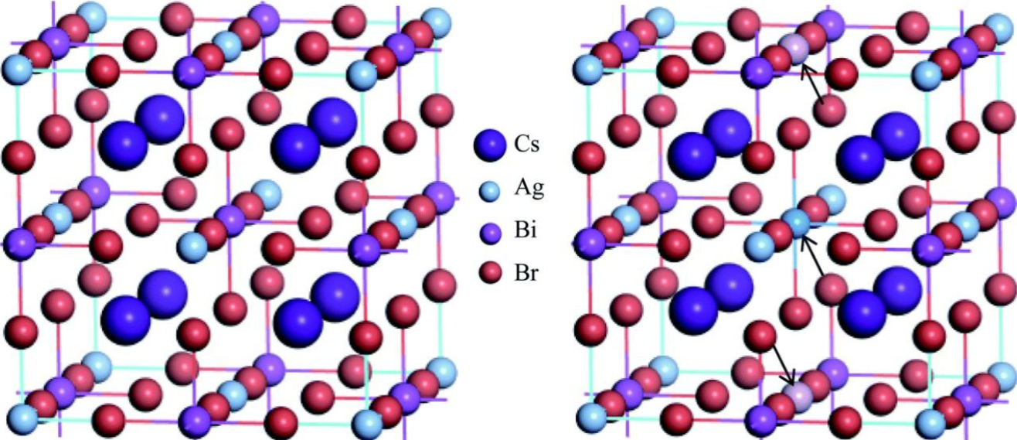
Hypothesis
We hypothesize that the decrease in the band gap associated with a change in the position and disorder of Ag and Bi atoms in the crystal lattice of Cs₂AgBiBr₆ is caused by the disorder affecting the orbital hybridization in the material.

Slide 6
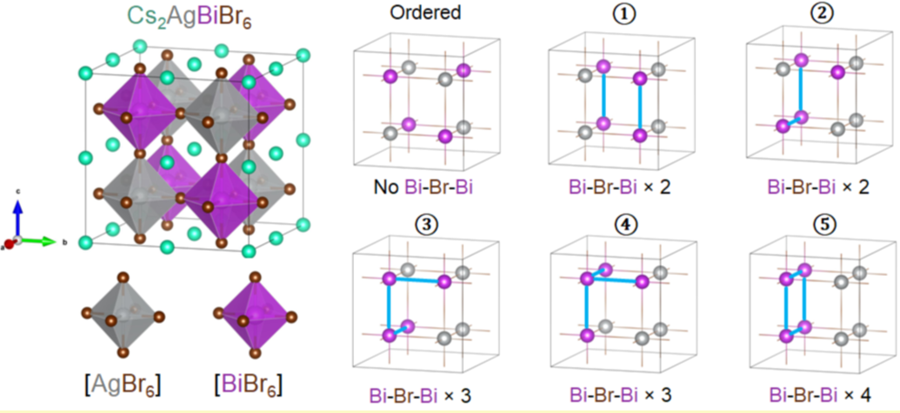
Methods
In order to start experimenting our hypothesis, we need to construct disordered structures. To do that, we manually exchange the positions of Ag and Bi atoms in the conventional call of Cs₂AgBiBr₆;

Slide 7
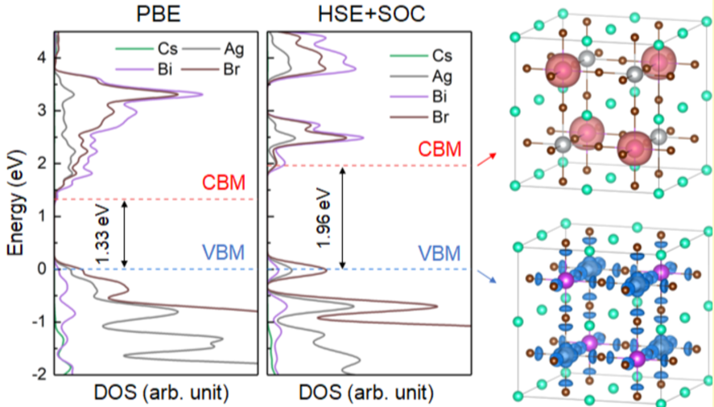
Methods
To get the band gap of a atomistic model we can use PBE or HSE+SOC methods. PBE tends to underestimate the band gap but, HSC+SOC band gap are closer to the experimental data..

Slide 8
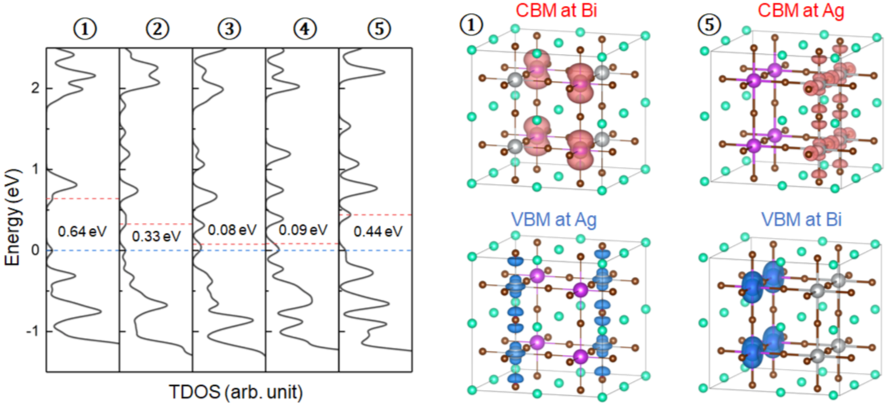
Methods
TDOS (total density of states)

Slide 9
Thank you for your attention!

