Slide 1
Data Compression Strategies for Enhancing IoRT Communications over Heterogeneous Terrestrial-Satellite Networks
HSE Tikhonov Moscow Institute of Electronics and Mathematics
Moscow, 2023
Alexander Karnaukhov, Artem Idelevich, Alexey Rolich, Leonid Voskov
Alexander Karnaukhov – speeker

Slide 2
Data Compression Strategies for Enhancing IoRT Communications over Heterogeneous Terrestrial-Satellite Networks
Introduction
Filed of research
Internet of Remote Things , IoRT – organization of Internet of Things network in the regions with poorly developed network infrastructure
Object of research
Data, transmitted from IoT devices
Compression algorithms

Slide 3
Data Compression Strategies for Enhancing IoRT Communications over Heterogeneous Terrestrial-Satellite Networks
Introduction
Problems:
High cost of data transmission from sensors
Low bandwidth of the communication channel
Main factors:
Transmission message volume
Overhead to payload ratio
Solution:
Modification of existing compression algorithms
Creation of data preprocessing method

Slide 4
Data Compression Strategies for Enhancing IoRT Communications over Heterogeneous Terrestrial-Satellite Networks
LoRa Iridium
Specifications:
Complete coverage (polar regions included)
Low Earth Orbit type (LEO)
Speed up to 128 Kbps
Offers M2M equipment based on SBD
Low power consumption
Max size of SBD package 340 bytes
Heterogeneous long range (LoRa)-Iridium network architecture

Slide 5
Data Compression Strategies for Enhancing IoRT Communications over Heterogeneous Terrestrial-Satellite Networks
GDEPC method
Methods for improving energy efficiency
3-step GDEP serialization and compression method;
Stages of SBD packet generation using GDEP serialization and compression algorithm

Slide 6
Data Compression Strategies for Enhancing IoRT Communications over Heterogeneous Terrestrial-Satellite Networks
Compression algorithms
Compression algorithms
Lossless
With loss
Entropy
With dictionary
Based on different principals
Compression algorithms types

Slide 7
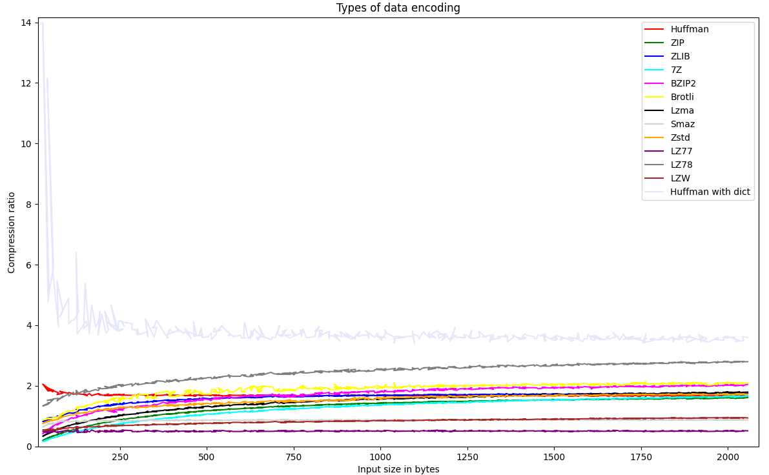
Compression algorithms comparisons
Data Compression Strategies for Enhancing IoRT Communications over Heterogeneous Terrestrial-Satellite Networks
Compression algorithms comparisons

Slide 8
Compression algorithms comparisons
Data Compression Strategies for Enhancing IoRT Communications over Heterogeneous Terrestrial-Satellite Networks
Compress type | Minimum compress ratio | Maximum compress ratio
Huffman Ex. Dict | 3.35 | 8.20
LZ78 | 1.42 | 2.78
Protobuff | 0.82 | 2.38
Brotli | 0.89 | 2.09
BZIP2 | 0.56 | 2.02
Huffman | 1.66 | 1.89
Lzma | 0.42 | 1.77
Compress type | Minimum compress ratio | Максимальный коэффициент сжатия
ZLIB | 0.86 | 1.75
Zstd | 0.80 | 1.72
7z | 0.22 | 1.64
ZIP | 0.27 | 1.60
LZW | 0.54 | 0.94
Smaz | 0.74 | 0.87
LZ77 | 0.48 | 0.50
Compression ratio comparisons

Slide 9
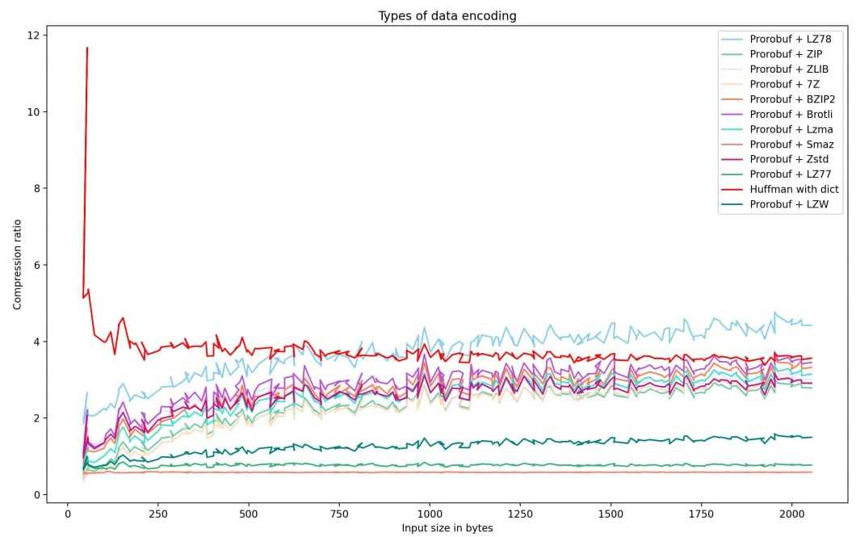
Compression algorithms comparisons
Data Compression Strategies for Enhancing IoRT Communications over Heterogeneous Terrestrial-Satellite Networks
Compression algorithms + ProtoBuf serialization comparisons

Slide 10
Compression algorithms comparisons
Data Compression Strategies for Enhancing IoRT Communications over Heterogeneous Terrestrial-Satellite Networks
Compress type | Minimum compress ratio | Maximum compress ratio
Huffman Ex. Dict | 3.35 | 7.92
Protobuf + LZ78 | 2.02 | 4.47
Protobuf + Brotli | 1.22 | 3.42
Protobuf + BZIP2 | 0.99 | 3.31
Protobuf + Lzma | 0.74 | 3.13
Protobuf + ZLIB | 1.32 | 3.04
Protobuf + Zstd | 1.16 | 2.94
Compress type | Minimum compress ratio | Maximum compress ratio
Protobuf + 7z | 0.44 | 2.93
Protobuf + ZIP | 0.52 | 2.82
Protobuf + Huffman | 1.66 | 2.39
Protobuf | 0.87 | 2.37
Protobuf + LZW | 0.74 | 1.49
Protobuf + LZ77 | 0.72 | 0.77
Protobuf + Smaz | 0.56 | 0.58
Compression algorithms + ProtoBuf serialization comparisons

Slide 11
Data Compression Strategies for Enhancing IoRT Communications over Heterogeneous Terrestrial-Satellite Networks
Data preprocessing
Example of method before preprocessing
Head – 37 byte
id – 36 byte
room_id/id – 11 byte
noted_date – 17 byte
temp – 2 byte
out/in – 2 byte
delimiters – 4 byte
(109 byte)
Translating data from initial format to binary format
(73 byte)
Protobuf can’t compress strings
Binary format compression
(46 byte)

Slide 12
Data Compression Strategies for Enhancing IoRT Communications over Heterogeneous Terrestrial-Satellite Networks
Data preprocessing
Method:
Stage 1
Choose both the original and binary formats for messages.
Stage 2
Process the originally selected format, replacing string values with numeric equivalents and creating a specific dictionary mapping certain typed strings to corresponding numerical values.
Stage 3
Converting the original format into binary forms using Protobuf
Stage 4
Compress the messages in binary format
Start
Data is received from IoT devises
Replacing string data with numeric equivalents
Dictionary creation
(Strings to numbers map)
Converting data to Protobuf format
Compressing data with Huffman algorithm
Dictionary creation for data decompression
Data sending
End

Slide 13
Data Compression Strategies for Enhancing IoRT Communications over Heterogeneous Terrestrial-Satellite Networks
Data preprocessing
Example of proposed method work
Head – 37 byte
id – 36 byte
room_id/id – 11 byte
noted_date – 17 byte
temp – 2 byte
out/in – 2 byte
delimiters – 4 byte
(109 byte)
Preprocessing of initial data format
(57 byte)
Head – 37 byte
id – 1 byte
room_id/id – 1 byte
noted_date – 11 byte
temp – 2 byte
out/in – 1 byte
delimiters – 4 byte
Translating preprocessed initial data format to binary format
(8 byte)
Binary format compression
(4 byte)

Slide 14
Data Compression Strategies for Enhancing IoRT Communications over Heterogeneous Terrestrial-Satellite Networks
Data preprocessing
Initial data format | Final data format | Mean initial file size (byte) - $S_{o}$ | Mean compressed file size (byte) - $S_{c}$ | Mean Compression ratio: $k= \frac{S_{o}}{S_{c}}$
CSV | Preprocessed compressed Protobuf | 342.278717 | 12,015515 | 28.486395
Proposed method Compression results

Slide 15
Data Compression Strategies for Enhancing IoRT Communications over Heterogeneous Terrestrial-Satellite Networks
Conclusion
Results:
There were presented data compression strategies for enhancing IoRT communications over heterogeneous terrestrial-satellite networks.
There was conducted a comprehensive exploration of various compression algorithms tailored for tiny IoRT data.
There were identified the most efficient compression algorithms combined with ProtoBuf serialization.
There was introduced a novel data preprocessing method prior to serialization, offering the potential to enhance the overall performance of the data processing pipeline, encompassing serialization and compression.

Slide 16
Data Compression Strategies for Enhancing IoRT Communications over Heterogeneous Terrestrial-Satellite Networks
Future work
Future work:
Adaptation of the preprocessing method for smart city datasets and other IoT areas
Commercialization of obtained results from satellite providers
Development of a universal preprocessing method for various IoT areas

Slide 17
Data Compression Strategies for Enhancing IoRT Communications over Heterogeneous Terrestrial-Satellite Networks
Acknowledgemen
Acknowledgement :
The publication was prepared within the framework of the Academic Fund Program at HSE University “Data Compression Strategies for Enhancing IoRT Communications over Heterogeneous Terrestrial-Satellite Networks”

Slide 18
Data Compression Strategies for Enhancing IoRT Communications over Heterogeneous Terrestrial-Satellite Networks
HSE Tikhonov Moscow Institute of Electronics and Mathematics
Moscow, 2023
Alexander Karnaukhov, Artem Idelevich, Alexey Rolich, Leonid Voskov
Alexander Karnaukhov – speeker

