Slide 1
QoS Metrics Measurement in Long Range IoT Networks
An experimental study of LoRaWAN metrics for the low-rate overlay scenario
Andrey Dvornikov, Pavel Abramov, Sergey Efremov, Leonid Voskov
National Research University Higher School of Economics (HSE)
Moscow, Russia
advornikov@hse.ru, psabramov@edu.hse.ru, sefremov@hse.ru, lvoskov@hse.ru
Higher School of Economics , Moscow, 2017
www.hse.ru
Notes:
Hello, my name is Pavel Abramov and today I would like to present the study of “QoS Metrics Measurement in Long Range IoT Networks”. This experimental study is prepared by four authors: Andrey Dvornikov, Sergey Efremov, Leonid Voskov, and myself, we represent the National Research University Higher School of Economics, Moscow.

Slide 2
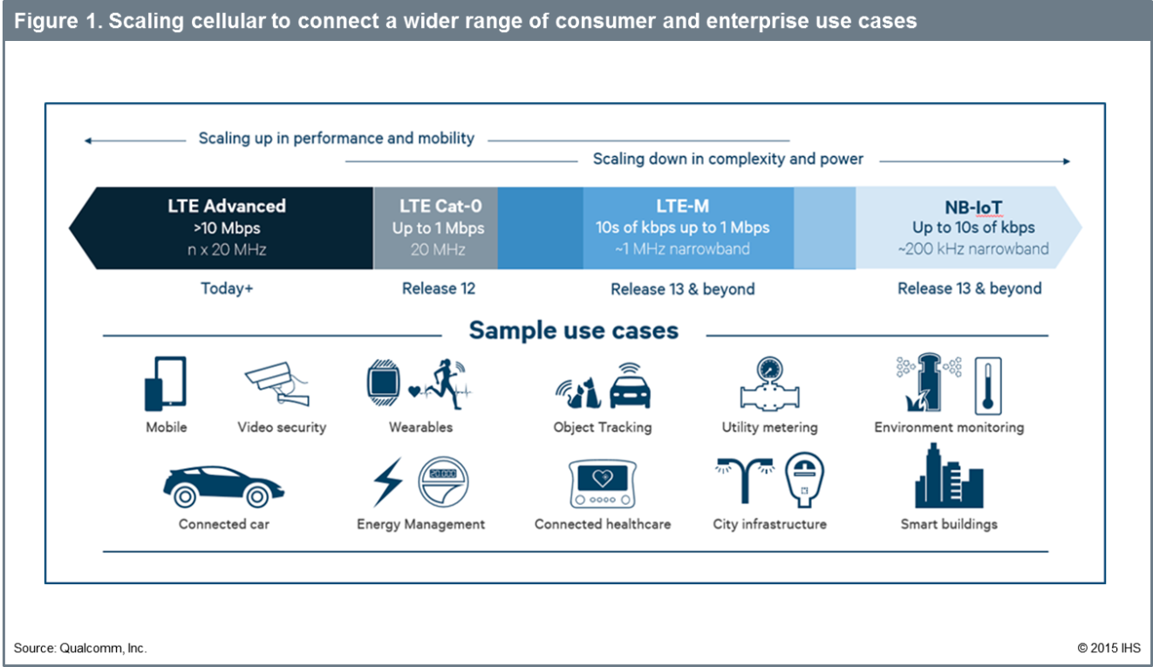
Relevance
Higher School of Economics , Moscow, 2017
Notes:
In our work we focus on Low Power Wide Area Networks or LPWAN. It is a new type of networks that aim to provide long distance communications using low-power transceivers. These networks tend to have a developed infrastructure with numerous nodes, stand-alone power supplies and high level of network isolation. All this makes them a solid solution for building IoT systems, in which wireless nodes cover large areas. Now my colleague Andrey Dvornikov will explain key idea of building low-rate overlay networks.
// NB- IoT - большая сфера Sigfox, LTE

Slide 3
Relevance
Low-rate overlay scenario over LPWAN
Higher School of Economics , Moscow, 2017
Higher School of Economics , Moscow, 2017
Notes:
In our particular study we discuss the possibility of building overlays on top of LPWAN. Even though these have to do nothing with traditional overlay clients, like Torrent, Tor, XMPP, VPN and so on, low-rate overlays are still possible. They can be important e.g. for emergency situations when communication backbones become unavailable. It is possible to send text information, coordinates and even low-quality photographs over these low-rate overlay networks. However the network reliability is crucial. Hence, Quality of Service metrics are important when the low-rate overlay network is organized.
In the overlay scenario QoS have to be considered for both networks: the base one and the overlay to prevent malfunction of any of the two.
In one of our previous works we proposed an approach for converting WSN QoS quotas to overlay networks QoS quotas. Still, the issue of QoS in LPWAN lacks a more in-depth research.

Slide 4
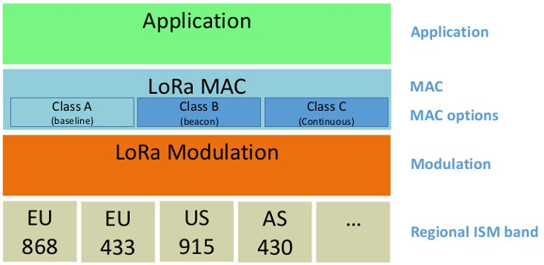
Relevance
LoRa:
Wireless modulation technology
Physical layer for long range communications
Low bandwidth and battery usage
Operates in the license-free ISM bands everywhere
Sensitivity: -142 dBm
Link budget (EU): 156 dB
LoRaWAN
LoRa
Higher School of Economics , Moscow, 2017
Notes:
At the moment one of the most adopted solutions for LPWAN networks is Semtech LoRa, which can achieve up to 15 km range with maximum bandwidth up to 290 bps with CSS spread spectrum. For lower distances maximum data rates can get up to 50 kbps with FSK modulation, CSS spread spectrum having slightly lower numbers. Besides, there is information about farther ranges of 37 km in the experimental study. Most LoRa solutions are based on the LoRaWAN stack provided by the LoRa Alliance. LoRaWAN allows to build a star-of-stars network, in which every gateway listens a node uplink and only the nearest gateway provides downlink to the node.
More details about LoRa specifics

Slide 5
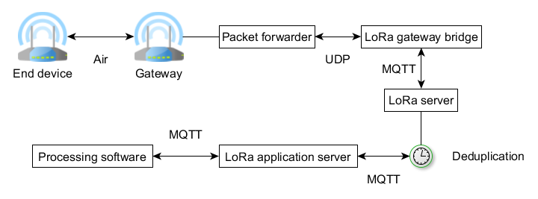
Related work
LoRa packet processing architecture
Higher School of Economics , Moscow, 2017
Notes:
In the related works we’ve analysed the following characteristics were measured for LPWAN: RSSI, SNR, PER, PDR, connectivity range, packet time on air. These are all important metrics used for QoS. Still, to the best of our knowledge there is no experimental study that provides measurement of the full packet delay in LoRa/LoRaWAN. We understand the packet delay metric as a total delay that results from a packet being processed by the LoRaWAN infrastructure including its hardware and software parts, not just the time on air. That means, packet delay metric is crucial for the most overlays over the low-rate network. We will also study the delay in terms of how it depends on distance between the two nodes.

Slide 6
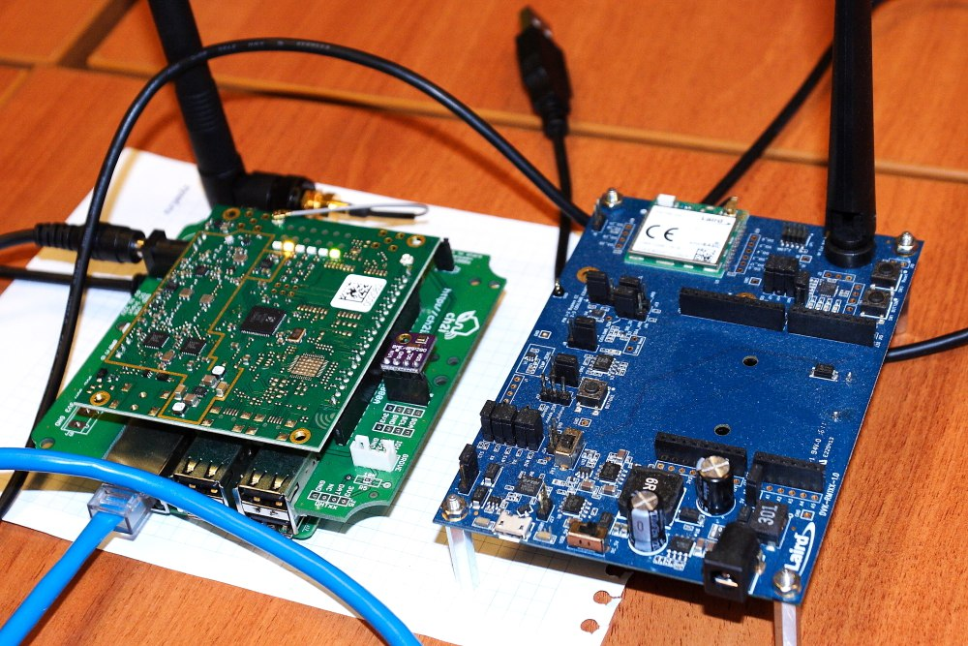
Experimental setup
Gateway based on RaspberryPi 2 with iC880A Shield
Laird DVK-RM186-SM-01 development kit
Higher School of Economics , Moscow, 2017
Notes:
We measure QoS metrics using LoRaWAN equipment that is shown on the slide. Both devices are fitted with omnidirectional antennas. The gateway software is based on the Open Source lora server project and uses default or recommended settings for its configuration. Interserver communication uses MQTT protocol. We use mosquito server to provide MQTT protocol support and postresql server to keep nonvolatile server storage.

Slide 7
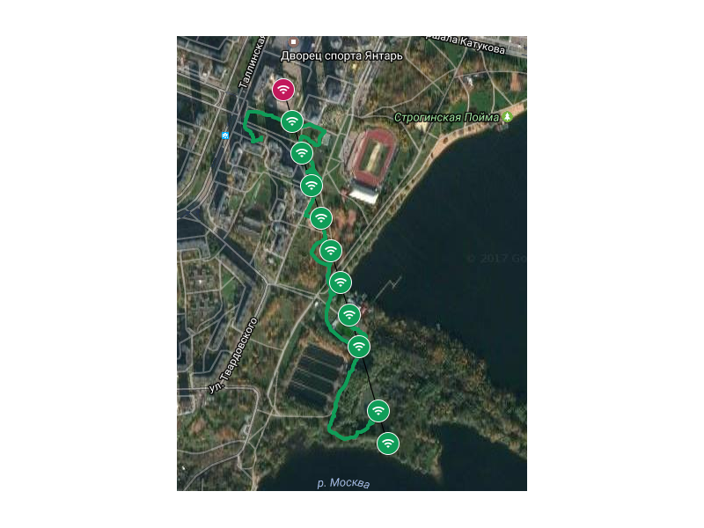
Experimental study
Experimental study:
Total track length 1150m
Track divided into steps about 100m long
Every metric was measured 3 times per point
Higher School of Economics , Moscow, 2017
Notes:
My personal role in the project was to carry out the experiment.
Our experiment, conducted in Moscow near Stroginskaja pojma, aimed to study QoS metrics change with distance between the stationary LoRaWAN gateway and the mobile LoRaWAN end device. The chosen area has semi-urban environment.
For the experimental study, the end device was configured for a fixed data rate with a channel bandwidth of 125 kHz and a spreading factor of 7. Because maximum bandwidth is more important than connectivity range by default. Channel selection was set to automatic mode.
On the experimental study map the gateway is marked as a red point on map, steps are marked as green circles.
The actual movement path was recorded with a GPS tracker to verify measurement points placement and is marked as a green line on the map.

Slide 8
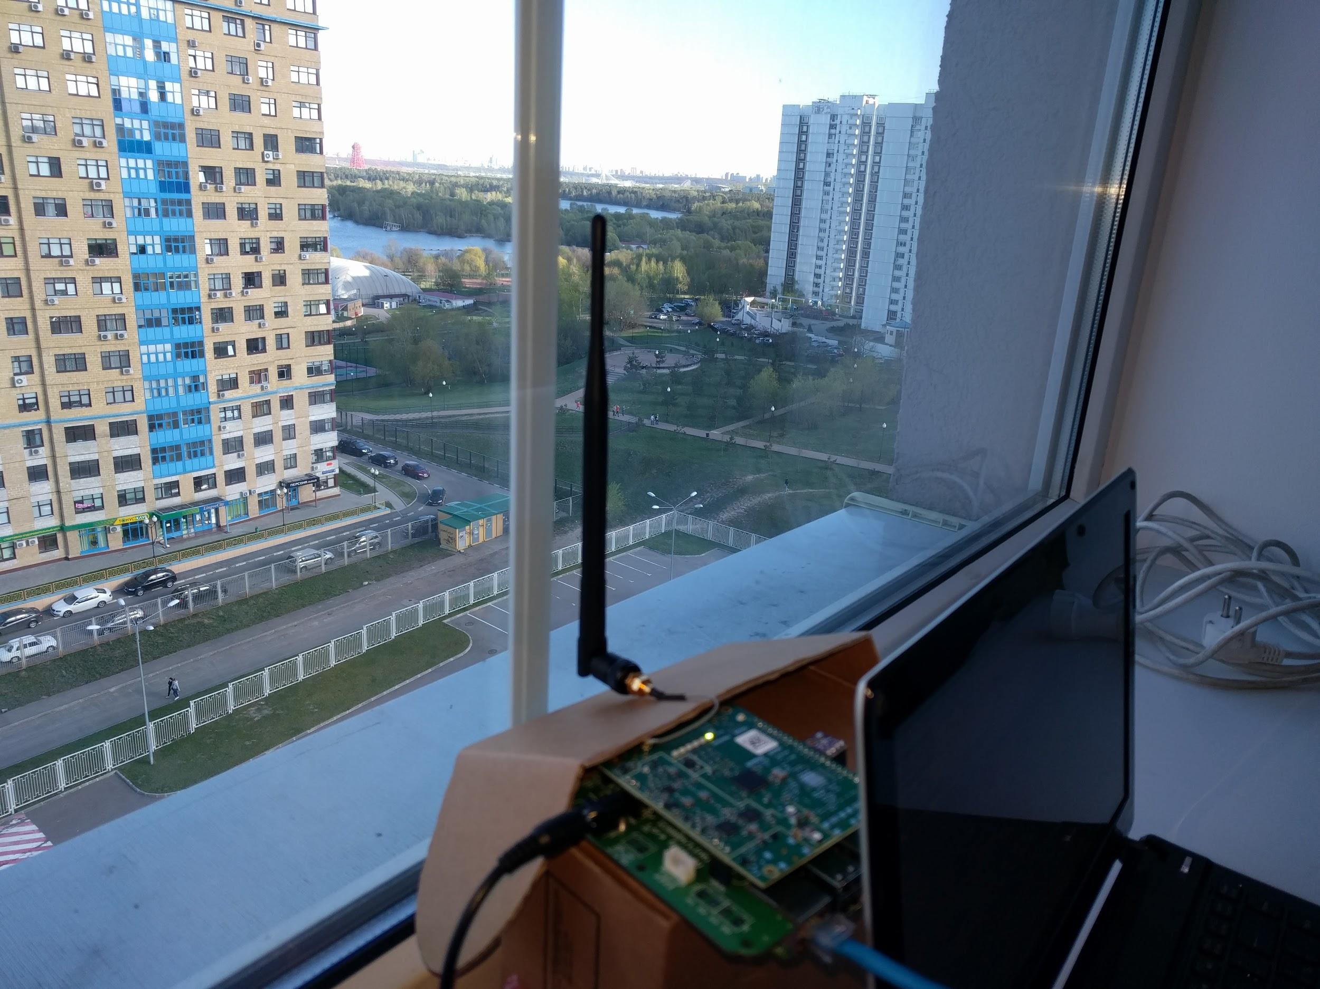
Higher School of Economics , Moscow, 2014
Notes:
We placed the gateway near the window on the the upper floor of the administrative building at our University’s MIEM campus, it’s about 29 m above ground level. The antenna position was selected to achieve the best direct line of sight for the planned measurement points. Still, some small objects like tree branches could block direct line of sight from different measurement points slightly affecting experimental results.

Slide 9
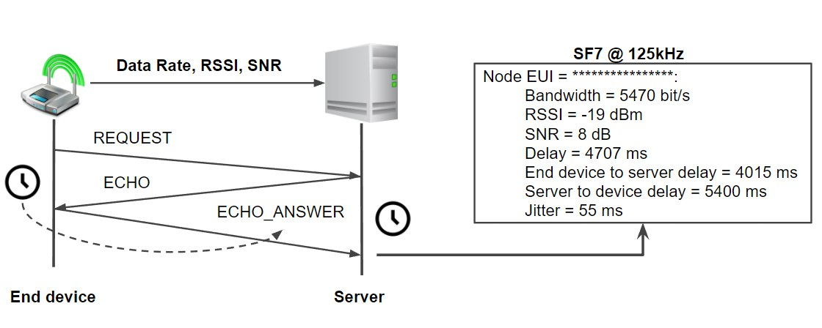
Experiment
Delay and jitter protocol diagram
Higher School of Economics , Moscow, 2017
Notes:
One of our important contributions was a specialized protocol that allowed to accurately measure the total packet delay.
It has three stages REQUEST, ECHO, and ECHO_ANSWER, as shown on the slide.
The end device measures delay between steps REQUEST and ECHO, the gateway in turn measures its own delay between steps ECHO and ECHO_ANSWER. The end device includes its results into ECHO_ANSWER packet for further processing on the gateway. The gateway calculates the final delay as an average value of delays measured on two communicating sides. From the second measurement iteration, the gateway calculates jitter as a mean difference between previously measured delay. An example of the metrics output from the experimental software is presented on box on the right.

Slide 10
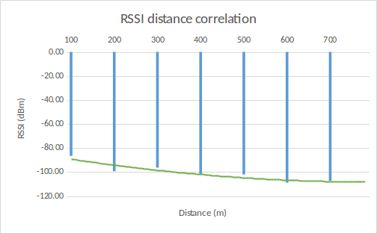
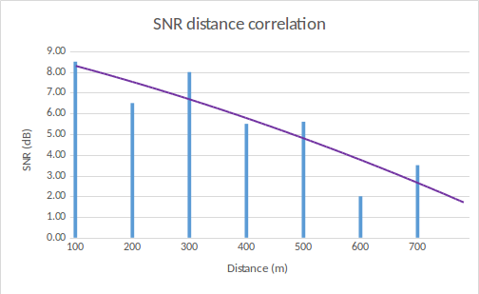
Discussion
RSSI, SNR:
Confirms the obvious decrease of RSSI
Maximal distance for the LoRaWAN connection was about 700 meters.
Spreading factor directly affects the maximum distance
Higher School of Economics , Moscow, 2017
Higher School of Economics , Moscow, 2017
Notes:
Apart from our main total delay metric we’ve measured common QoS metrics like RSSI The change of the RSSI metric with distance is shown in slide. The acquired data confirms the obvious decrease of RSSI as the end device was moved away from the gateway, we recorded the loss of readings at RSSI value lower than -107dBm (point #8). Point #9 was additionally checked and no communication was recorded.
The maximal distance for the LoRaWAN connection in our experiment was about 700 meters. However, even at 1 km the network registration phase that is performed at 125 kHz bandwidth with a spreading factor of 12 still succeeded. In our study, we selected a data rate with the highest bandwidth because this is the best condition for the low-rate overlays approach. We hence had to keep the spreading factor as low as possible.

Slide 11
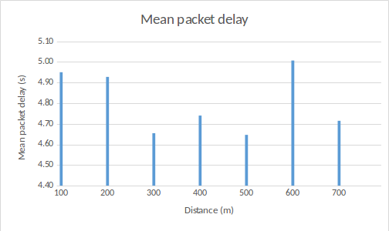
Discussion
Mean packet delay (av. between the end device to server delay and server to end device delay)
Change in delay is likely a random fluctuation caused by a sum of delays
Higher School of Economics , Moscow, 2017
Higher School of Economics , Moscow, 2017
Notes:
The mean packet delay as a function of distance is presented in this slide. The mean delay is about 4,81 s for our equipment and software setup and the changes with distance aren’t very significant.
The resulting delay can be decreased using additional configuration steps for the server components. Unconfigurable parts in our scenario are the end device’s LoRaWAN driver, LoRa transceiver and the gateway’s LoRa transceiver. As we found out, the MQTT packet transactions form the most significant part of the packet delay. However, the exact reasons require further investigation.

Slide 12
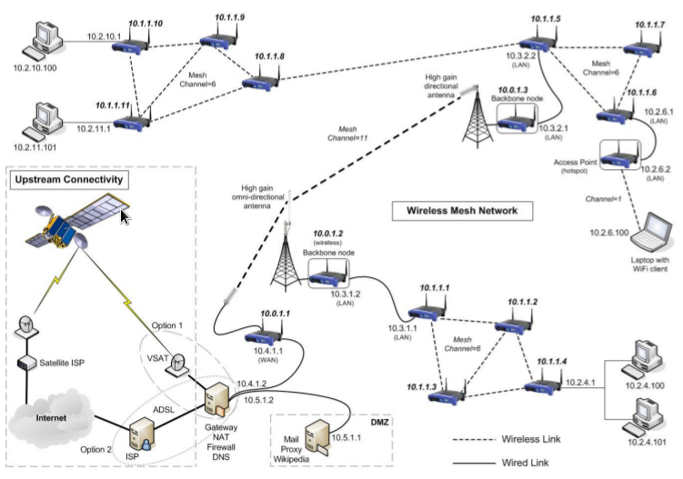
Potential LPWAN solutions
Mesh network on LoRa
Higher School of Economics , Moscow, 2017
Notes:
\In addition, experiment pushed us to think about possibility of building Mesh network on LoRa.
Well, It’s possible to build a mesh topology on LoRa in theory, in this case an existing mesh protocol shall be adjusted to support the modulation format and other physical level characteristics of LoRa. This would be a significant engineering task especially for the scenario of fully autonomous networks. Besides, some of LoRa's specific characteristics like floating bit rates and long preambles need to be considered.
To provide a mesh solution over LoRa the MAC and network layers need to be provided. One of the possible solutions is to integrate a CSMA-like mechanism in MAC layer, however in this case there are certain issues like the duty cycle limitation that would prevent a network node from sending messages too frequently. If the current LoRa architecture is retained, the CSMA-like mechanism would have to be controlled by the network server, which would put even more load on it. Nevertheless, if current architecture is modified in a specific way, this task would not be as challenging as it is now.
To access a low-rate overlay network external clients can also use a different standard, like Bluetooth. There are LoRa modules in the market, that support bluetooth connection for short-distance communication. One of the reasons for switching to a different standard would be improving the number of potential client devices.

Slide 13
Conclusion
Conclusion:
Correlation between key QoS metrics and the distance between a node and a gateway is verified
The full delay of a packet is significant in value, independent from the distance
Further going:
Fine-tune the experimental equipment
Higher School of Economics , Moscow, 2017
Notes:
This work can be summarized as follows. An experimental study allowed to find correlation between key QoS metrics and the distance between a LoRaWAN node and a LoRaWAN gateway. Taking off-the-shelf components and online services with their initial settings we built a prototype and measured changes in RSSI, SNR, packet delay and jitter.
The full delay of a packet going through the LoRaWAN infrastructure turned out to be significant in value, remaining independent of the distance. This gives an opportunity to evaluate mean packet delay, which is crucial in emergency message overlay. Besides, RSSI, SNR results show correctness of the experiment.
In our future work, we plan to fine-tune the experimental equipment to see if we can drastically lower packet delay times, which may be required by certain type of overlay applications. Also, we’re planning to build up a prototype
of a LoRa system with emergency message overlay.
// Сделать прототип системы с оверлеями

Slide 14
20, Myasnitskaya str., Moscow, Russia, 101000
Tel.: +7 (495) 628-8829, Fax: +7 (495) 628-7931
www.hse.ru

