Slide 1
Informational and analytical system of dangerous celestial bodies monitoring, and asteroid and comet hazard counteraction planning
Hannover, June 2015

Slide 2
System application
Informational and analytical system of dangerous celestial bodies monitoring and asteroid and comet hazard counteraction planning (IAS ACH) is designed to provide Russian EMERCOM managers with integrated analytical information on the current situation, on possible options for interaction between hazardous celestial body with the atmosphere or the Earth's surface.

Slide 3
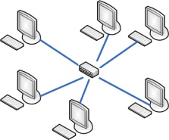
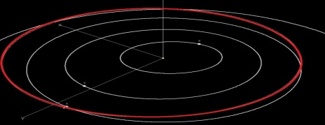
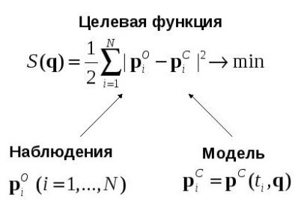
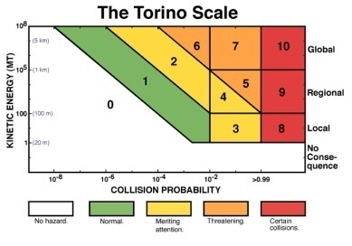
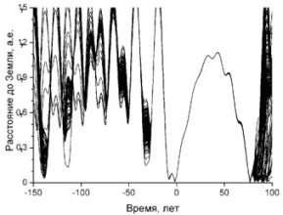
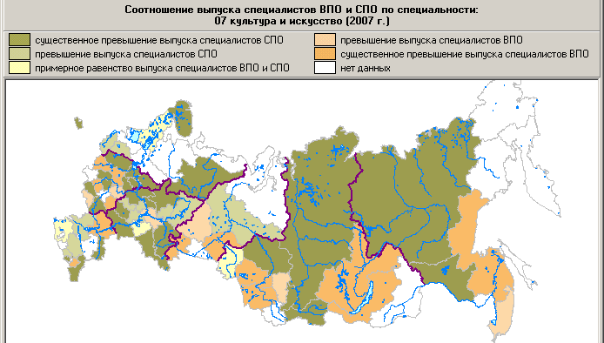
IAS ACH capability
Data collection and processing | Situation analysis, Processes modeling
1. Algorithms and programs of data collection | 4. Dangerous rendezvous ‘scenario modeling
2. Algorithms and programs of data processing | 5. Estimation of emergencies’ consequences
3. Algorithms and programs set of trajectory’s evolution calculation | 6. Results visualization
7. Recommendations and instructions for emergencies consequences prevention

Slide 4
IAS ACH structure
IAS ACH subsystems
- automated data collection subsystem;
- predictive and analytical subsystem;
- data visualization and publication subsystem.
Data stores including
- data base;
- data bank.
Notes:
Убрать модуль выдачи рекомендаций. Систему отчетных форм переименовать в Систему генерации отчетных форм и выдачи рекомендаций.

Slide 5
System’s modules application
Data stores is IAS ACH integrated information resource including data base and data bank that provides efficient data storage and fast access to near-Earth space monitoring data, as well as to the modeling, analysis and assessment results of current situation .
Data storage contains the observations data of research target, orbital and physical-chemical characteristics, trajectories’ evolution under different initial conditions, data for reproducing tasks solutions, associated guides, and full range of monitoring and analysis of hazardous celestial body parameters at all stages of its observations (up to the interaction moment with the atmosphere or the Earth’s surface).

Slide 6
Data bank of possible celestial bodies impact consequences on certain surface
Data bank includes
Catalog of hazardous celestial bodies and their parameters;
Specified trajectories of celestial bodies motion;
Characteristics’ impact of adverse factors and enclosed description;
Physical parameters describing quantitative characteristics of adverse factors;
Area’s boundary of adverse factors impact and enclosed description;
Electronic maps displaying interaction results;
External observation results of celestial body interaction with atmosphere or the Earth's surface;
Recommendations and guidelines for consequences prevention of emergency for the celestial body.

Slide 7
System’s modules application
Automated data collection subsystem is a subsystem for data input from various information sources in both manual and automated modes.
The subsystem provides control of the information received based on comparison with reference data generated by system administrator.

Slide 8
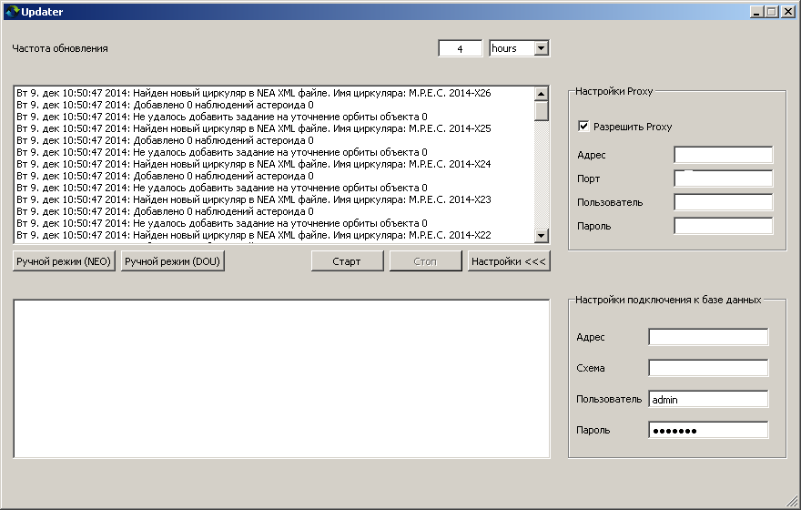
Automated data collection system
General view of data collecting module on observations of near-Earth objects

Slide 9
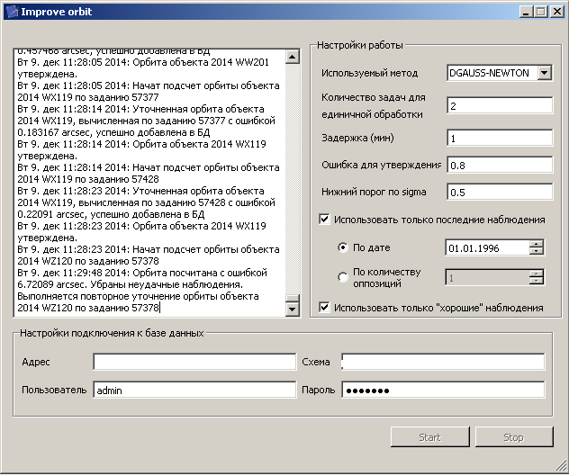
Automated data collection system
General view of data processing module on observations of near-Earth objects

Slide 10
System’s modules application
Predictive and analytical subsystem includes
Software for study of trajectories evolution of hazardous celestial bodies;
Determination module (specification) of hazardous bodies trajectories;
Study module of trajectories evolution, that allows identifying hazardous celestial bodies’ trajectories;
Estimation module of collision probability;
Determination module of body’s descent trajectory;
Estimation module of collision consequences.

Slide 11
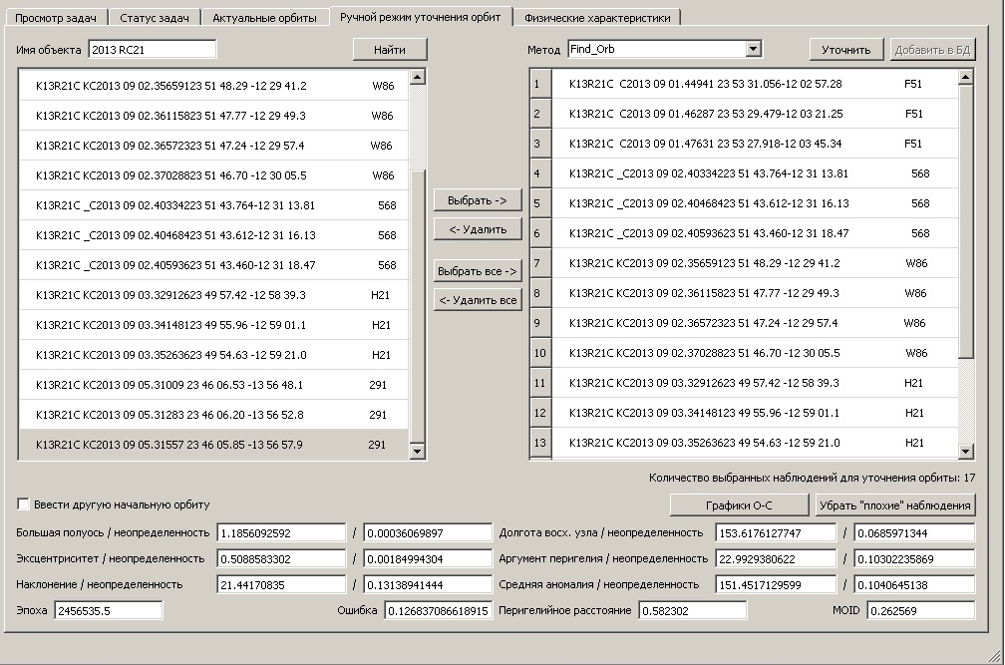
Predictive and analytical subsystem
Processing “Specification of body‘s trajectory in “manual mode”

Slide 12
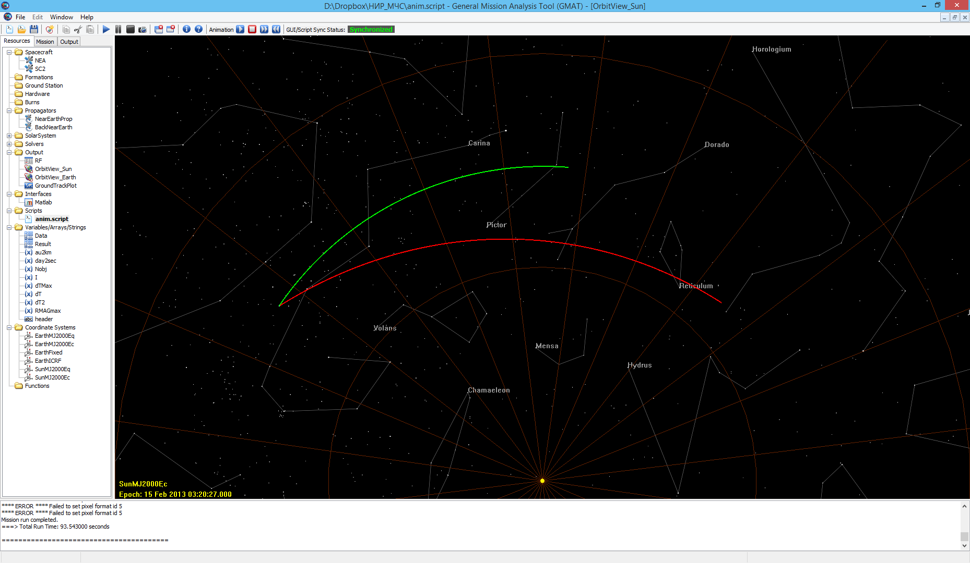
Software for study of trajectories evolution of hazardous celestial bodies
Visualization window
Chelyabinsk object’s motion animation
green line– Earth’s trajectory,
red line – hazardous celestial body’s trajectory
Notes:
Окно системы визуализации на основе программного пакета GMAT (General Mission Analysis Tool).
В гелиоцентрической системе координат отображены траектория Земли (зеленая линия) и траектория сближения околоземного объекта (красная линия).
Желтая точка внизу – Солнце.

Slide 13
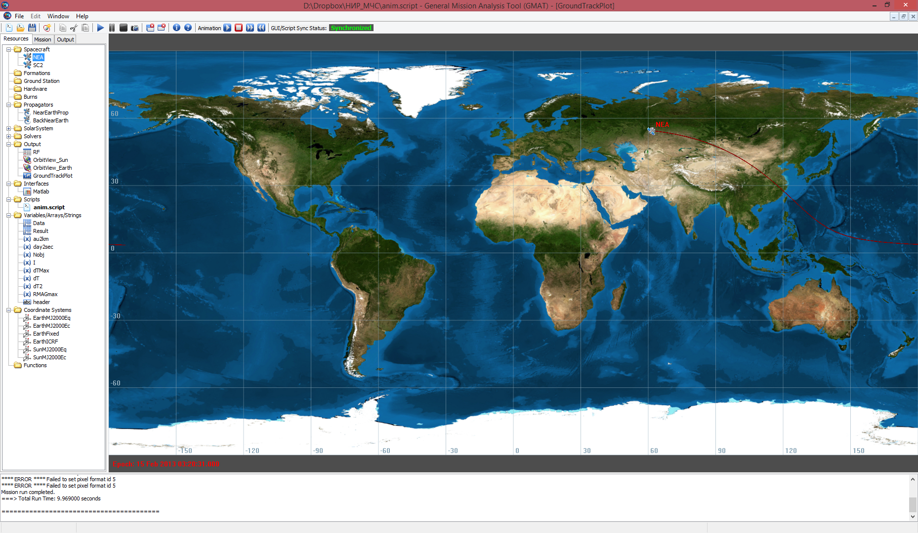
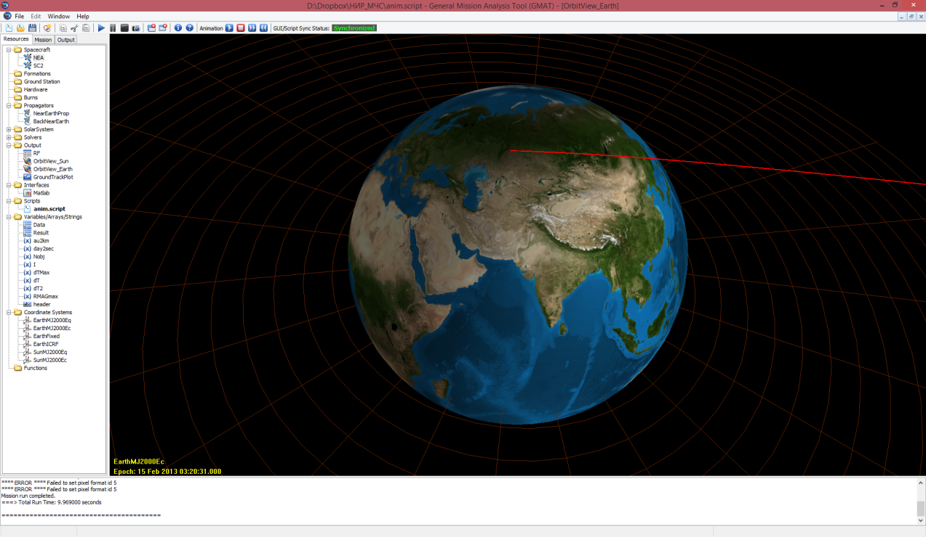
Software for study of trajectories evolution of hazardous celestial bodies
Trajectory and track of the Chelyabinsk object descent displaying in the visualization system

Slide 14
Estimation module of collision consequences of hazardous body with atmosphere or the Earth’s surface
Effects of dangerous celestial body’s interaction with an atmosphere and the Earth's surface
En route, spinning down and destruction of celestial body in the atmosphere
Air blast;
Thermal radiation and fires;
Electromagnetic disturbances;
Seismic effects;
Plume formation.
On reentry high-speed emissions
Acoustic gravitational wave;
Electromagnetic disturbances;
Thermal radiation and fires.
On surface impact and crater formation
Changes in relief;
Seismic effects;
Plume and air blast formation in the atmosphere;
Thermal radiation and fires;
Water emission;
Dust emission;
Emission of climate-active and/ or toxic gases;
Tsunami formation;
Electromagnetic disturbances;
Acoustic gravitational wave;
Chemical reactions in the atmosphere.

Slide 15
Estimation module of collision consequences of hazardous body with atmosphere or the Earth’s surface
Crater formation animation

Slide 16
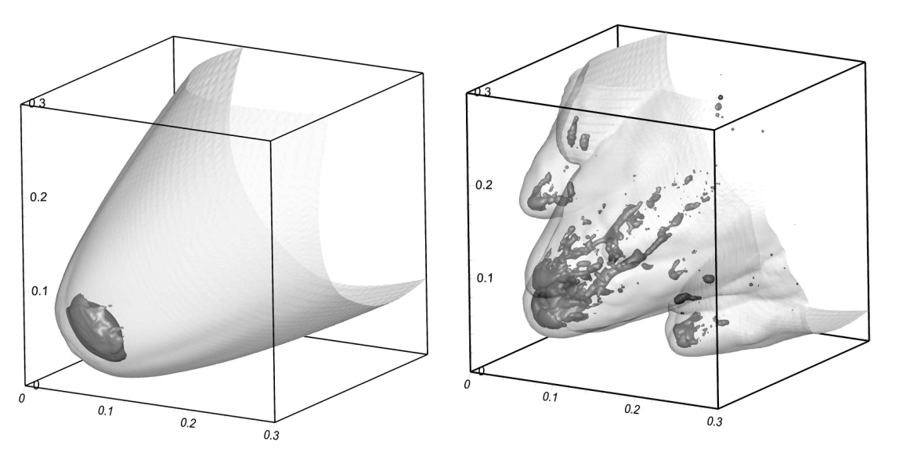
Estimation module of collision consequences of hazardous body with atmosphere or the Earth’s surface
Dying cometary origin meteoroid (ϱ~0.9 g/sm³, D~100m, V~50 km/s)
Typical event sequences
The descent body starts to evaporate, than deforms and breaks into fragments;
After fragments evaporation a mud jet forms consisting of vapor and heated due to shock wave air;
A highly-speed jet continuous its motion along the trajectory with a speed close to initial meteoroid speed;
A jet spins down and expands forming a wide cloud of heated and low density gas;
A cloud starts to rise up forming an atmospheric plume.

Slide 17
Possible impact scenario depending on size/ material and trajectory’s angle α :
Estimation module of collision consequences of hazardous body with atmosphere or the Earth’s surface
Solid comet’s parts (D>100 м) could reach the Earth when α ~ 90⁰;
500-meter asteroid , generally, could be burnt in atmosphere when α ~ 5⁰.
Violet ellipse characterize Tunguska meteoroid
The height of energy emission could be significantly reduced (for 10-20 km), if the effect of internal friction between the fragments is considered.

Slide 18
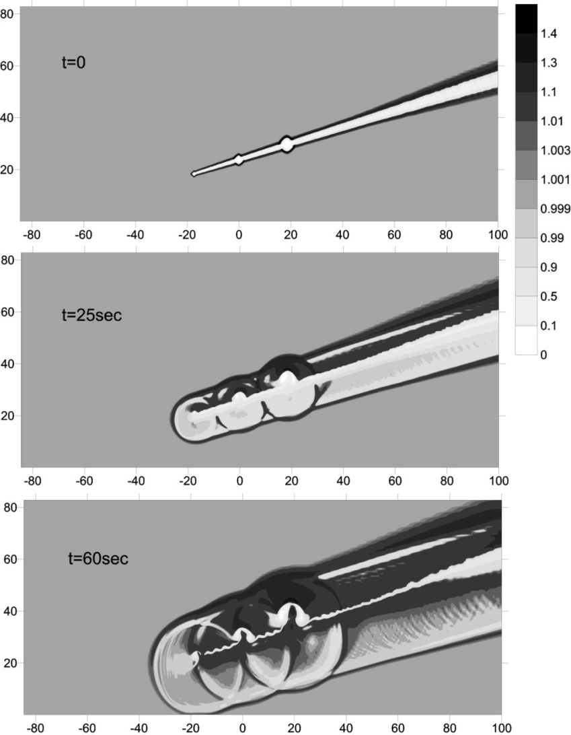
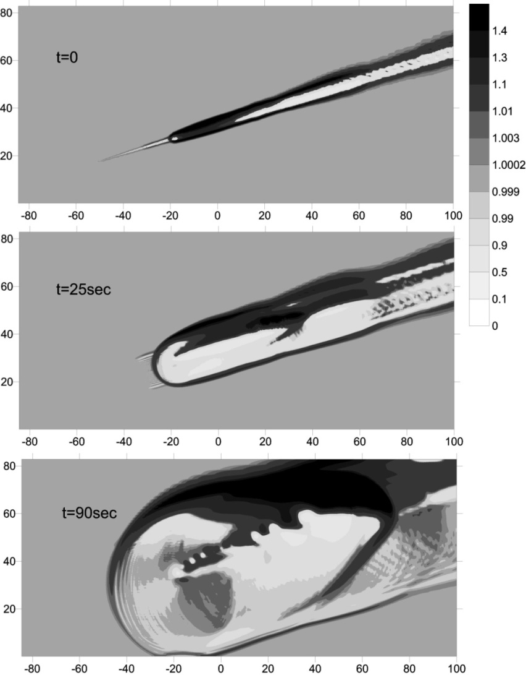
Estimation module of collision consequences of hazardous body with atmosphere or the Earth’s surface
Chelyabinsk bolide modeling
Energy type affects to density and pressure distribution in emerging perturbed region and to its evolution

Slide 19
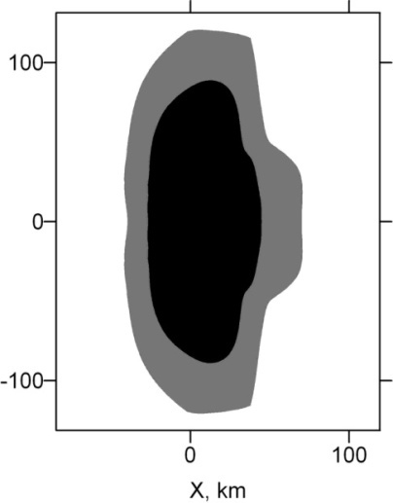
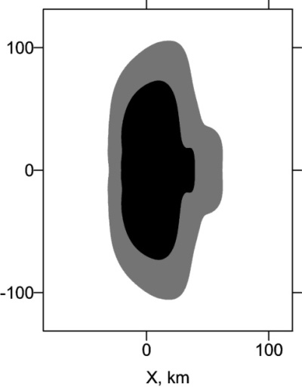
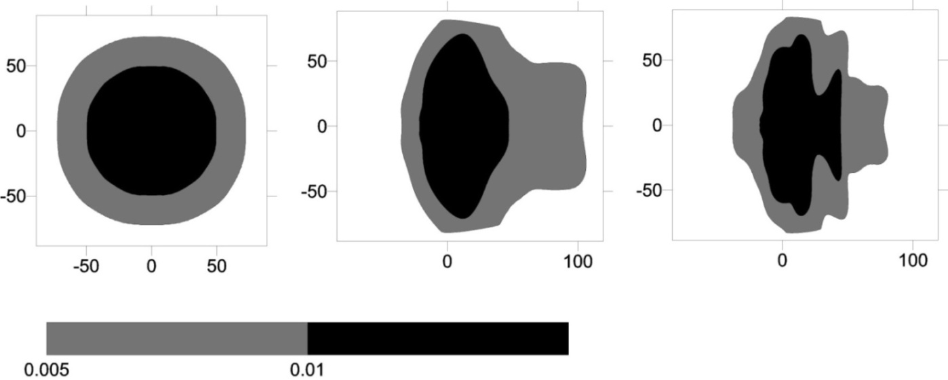
Estimation module of collision consequences of hazardous body with atmosphere or the Earth’s surface
Chelyabinsk bolide modeling
Pressure excess on the surface
(3)
(1)
(4)
(2)
Region size~ ³√ E
Region form ~ from energy emission, flyby and destruction in the atmosphere
Black region >1000 Pa, grey >500 Pa
Energy emission(dE/dz) is proportional the light curve (4), results in region form with pressure excess that is closer to conical case (2), than to the point explosion (1)

Slide 20
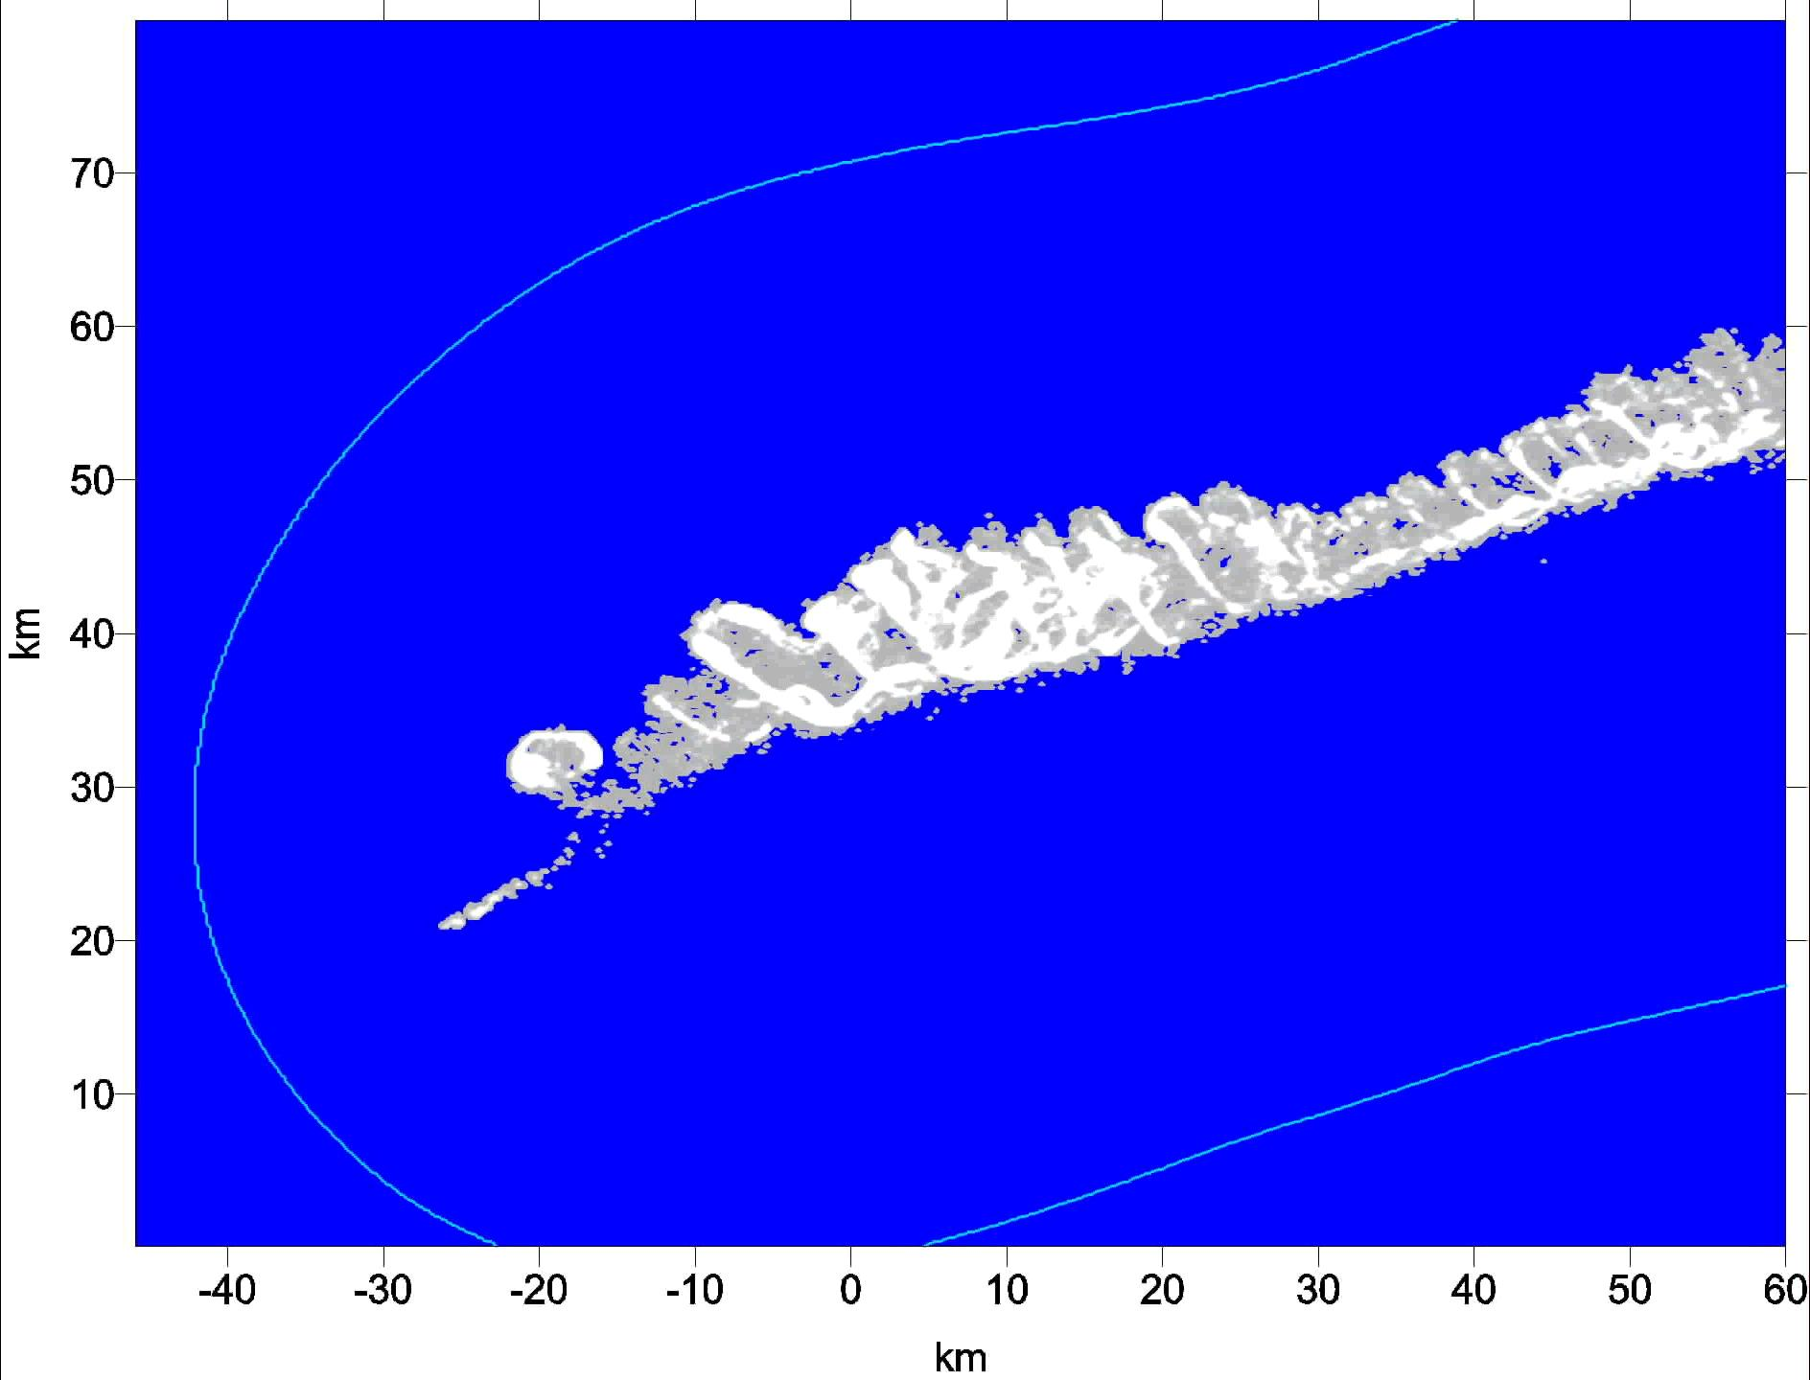
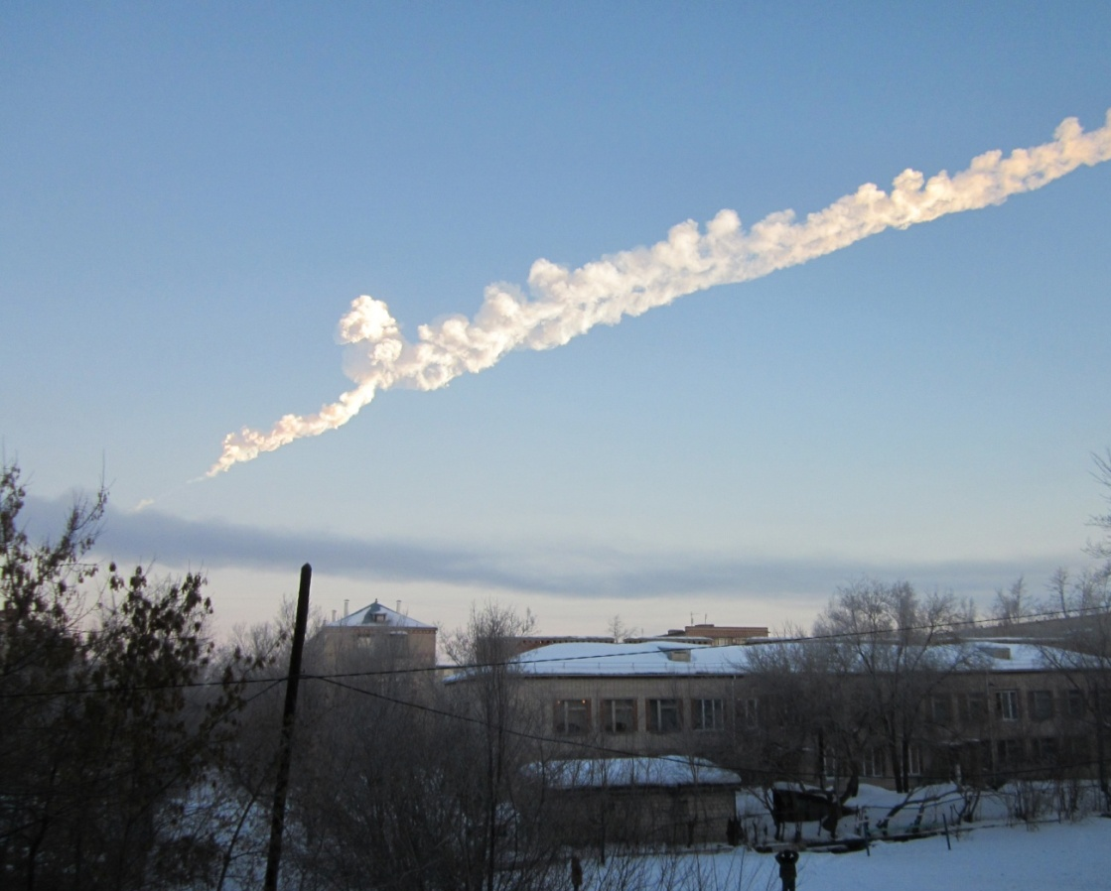
Estimation module of collision consequences of hazardous body with atmosphere or the Earth’s surface
Chelyabinsk bolide modeling
Pressure excess on the surface
model
photo
~85 km S

Slide 21
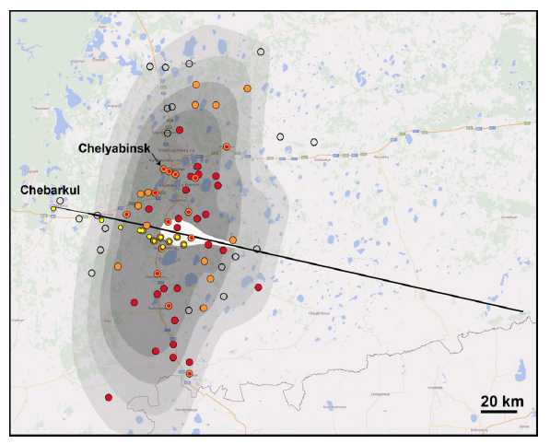
Estimation module of collision consequences of hazardous body with atmosphere or the Earth’s surface
Chelyabinsk bolide modeling
Data for glass break is contradictory
Pressure excess on the surface
Glass break
Δp (Pa)
5% 690
50% 1445
90% 3730
Mannan & Lees,2005,
Glass break
Δp (Pa)
5% 2000
10% 2500
90% 9000
Gelfand, Silnikov 2002
Contours
(from dark to light)
300 kt Δp>1000 Pa,
520 kt Δp>1000 Pa,
300 kt Δp>500 Pa,
520 kt Δp>500 Pa
- depends on size (often– schools, clubs, shops)
depends on thickness and local effects
(especially in the city)
Brown et al.: ~12% of glass was broken
Δp~2600-4000 Pa
We assumed
Δp~500 Pa – a few glass is broken
Δp~1000 Pa – significant number of glass is broken
Form of the damaged area is in accordance with following
- meteoroid energy escaped not at one point, but along a large part of trajectory
Red – destructions (official data)
Orange – destructions, field data
Dark unshaded – no destructions
Yellow – meteorites

Slide 22
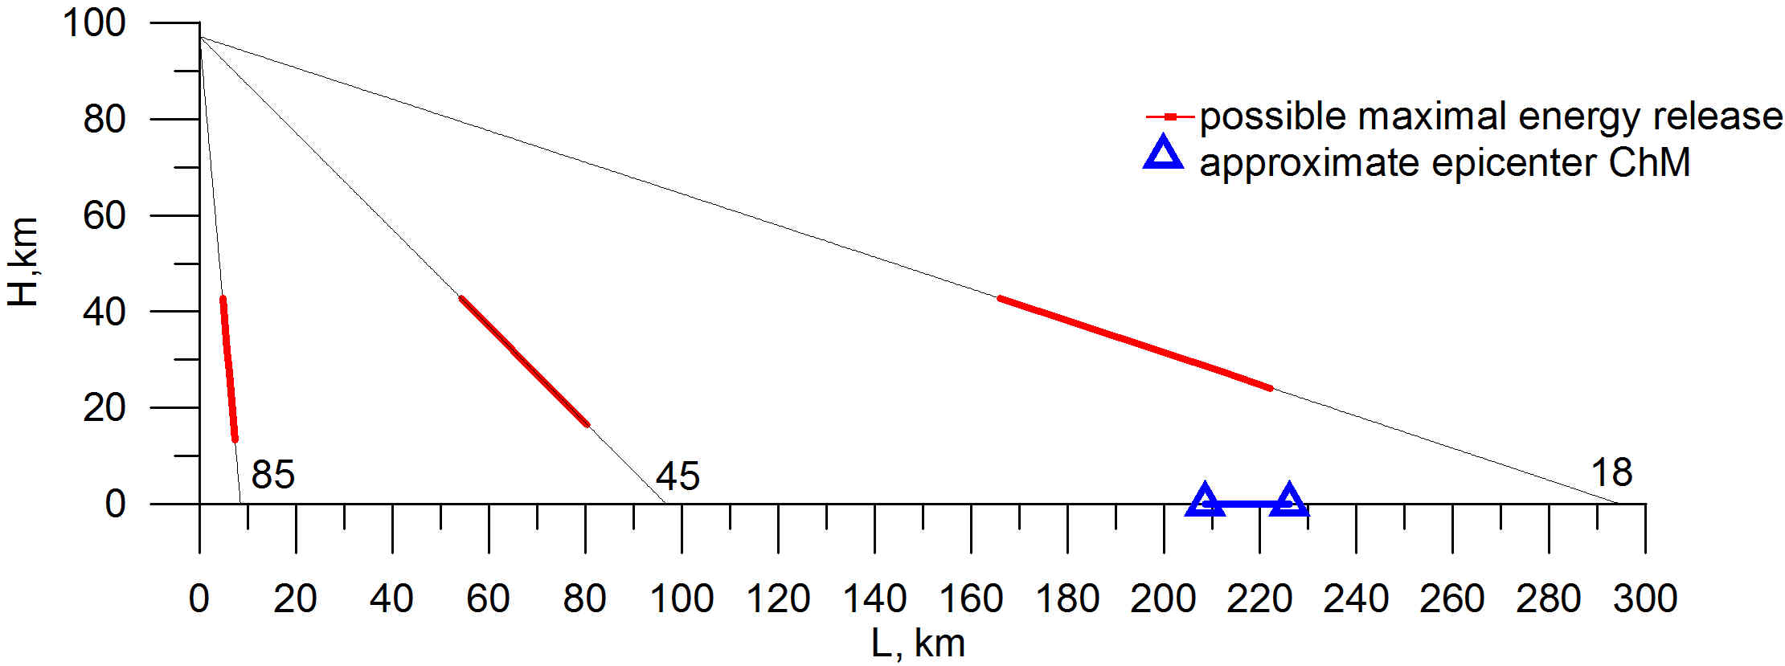
Estimation module of collision consequences of hazardous body with atmosphere or the Earth’s surface
Chelyabinsk bolide modeling
Depending on celestial body ‘s angle of entry into the atmosphere, center of intercept zone and effective height of energy emission are shifted.
Chelyabinsk meteoroid’s damage would be much greater if its trajectory was more vertical.

Slide 23
System’s modules application
Data visualization and publication subsystem provides
Reports forming, saving and printing;
Created reports export into standard office application;
Comprehensive data formation on hazardous celestial body allowing to evaluate impact degree on region and infrastructure objects.

Slide 24
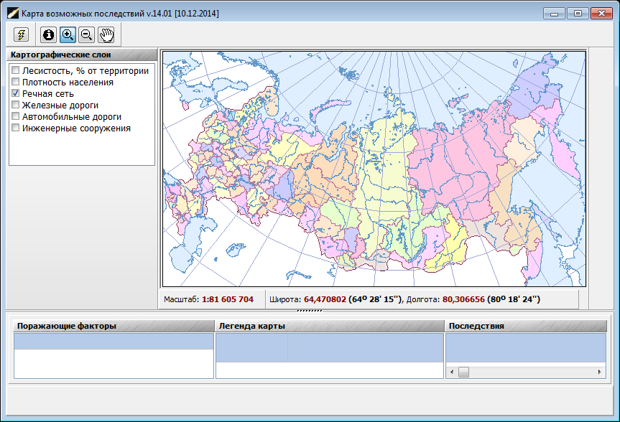
Data visualization and results publication subsystem
Initial module view of electronic maps preparation

Slide 25
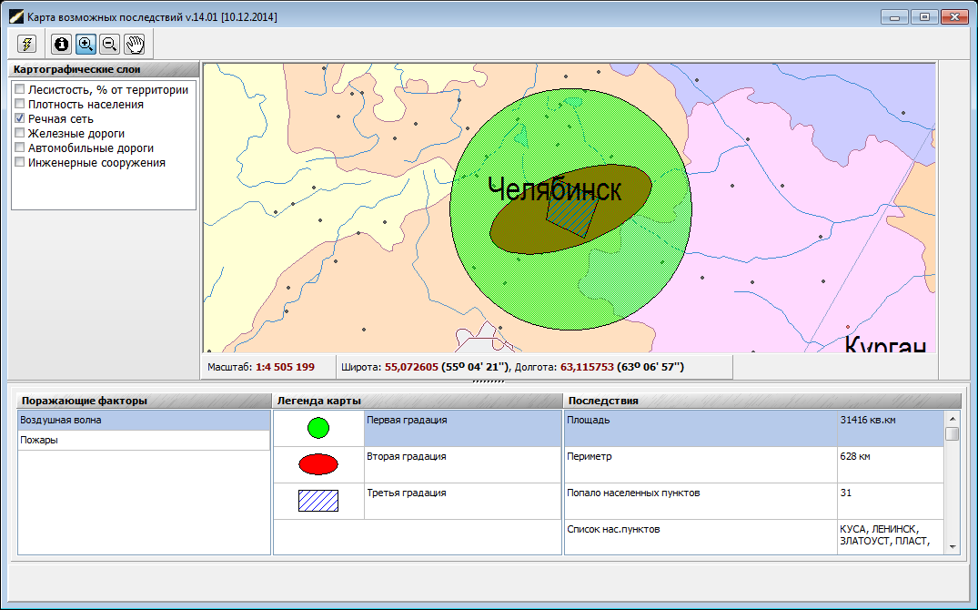
Data visualization and results publication subsystem
Adverse factor visualization (air wave)

Slide 26
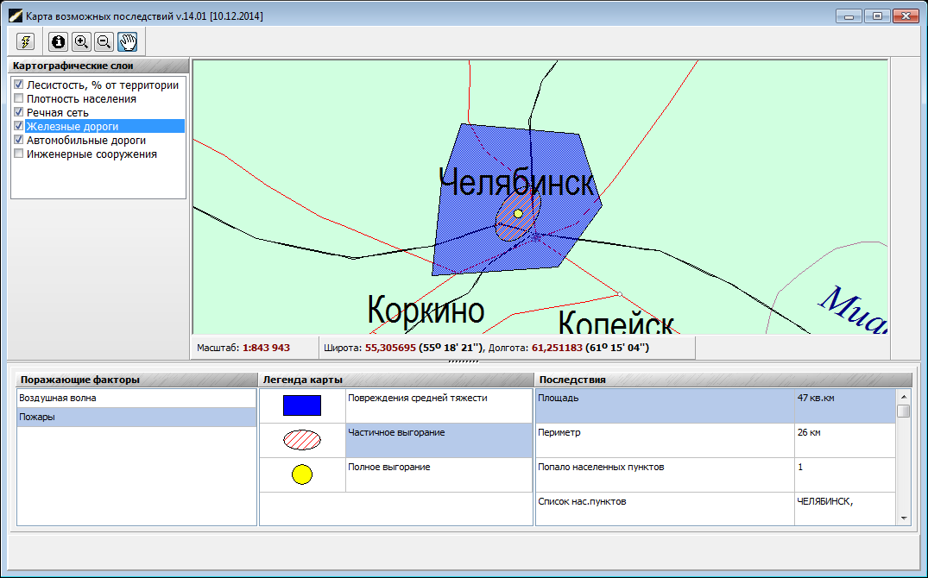
Data visualization and results publication subsystem
Adverse factor visualization (fires)

Slide 27
IAS ACH future developments
IAS ACH Integration with a unified state system of prevention and liquidation of emergency situations (RSE) will increase efficiency of decision support systems in emergency related to ACH.

Slide 28
IAS ACH future developments
IAS ACH Integration with a unified state system of prevention and liquidation of emergency situations (RSE) will increase efficiency of decision support systems in emergency related to ACH.

Slide 29
IAS ACH is designed by order of the Russian Ministry of Emergency Situations.
In system design following organization participated:
National research university “Higher school of economics”;
Institute of astronomy Russian academy of science;
Institute of geosphere dynamics Russian academy of science;
All-Russian research institute for civil defense and emergency situations of the Russian Ministry of Emergency Situations.

Slide 30
Thank you for attention!

